Slide 2



EpicCare Ambulatory
Epic Upgrade
August – November 2020

Slide 3

Reviewing the Chart

Slide 4
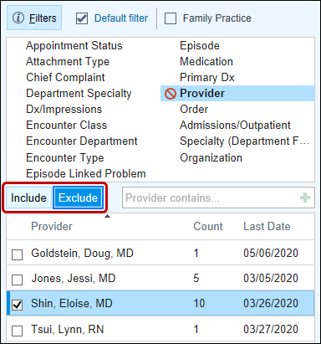
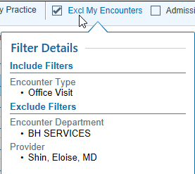
Chart Review, Leave That Out
Filter your Chart Review tabs using a new exclude option to more efficiently review patient information. For example, you can:
  Exclude your own notes, department, or specialty to get up to speed on a patient's visits with other providers.
  Hide basic patient paperwork, consents for care, or insurance information.
Hover over a filter to see which results are included and excluded.
Notes:
RN 726835

Slide 5
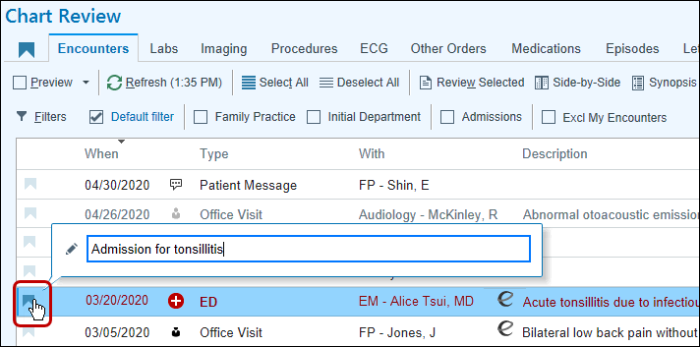
Bookmark Outside Encounters in Chart Review
Reviewing encounters from outside sources can give clinicians a broader view of the patient's care and help fill in gaps they might otherwise be unaware of. Clinicians can now bookmark and add comments to outside encounters to easily reference at a later time on the Bookmarks tab, alongside any other bookmarked data from the chart. The Care Everywhere icon indicates which encounters originated from outside your organization on the Bookmarks tab.
A clinician can click the bookmarks icon to add a comment about an outside encounter and revisit the information later on the Bookmarks tab.
Notes:
RN 735504

Slide 6

Storyboard Vitals Now Show BMI for Patients Under 21
To help you quickly review important vitals for children, Storyboard now shows BMI for patients younger than 21.
Notes:
RN 740768

Slide 7
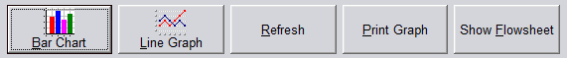
Bar Chart Button No Longer Appears in the Review Flowsheet Activity
The Bar Chart button has been removed from the Review Flowsheet Activity. Clinicians can still review data in the table and line graph format.
Notes:
NN 733699

Slide 8
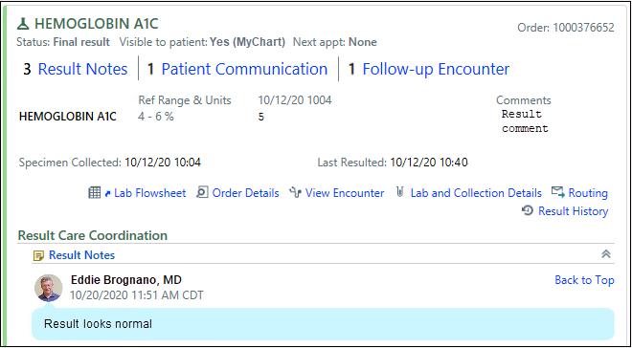
Navigate Through Results Quicker with a New Navigation Bar
Clinicians can see the number of result notes, patient communications, and follow-up encounters on a lab result and use links to jump to those specific sections. After they have reviewed the section, the clinician can jump to the top of the result by clicking Back to Top.
Notes:
RN - 765764

Slide 9
Notes and Documentation

Slide 10
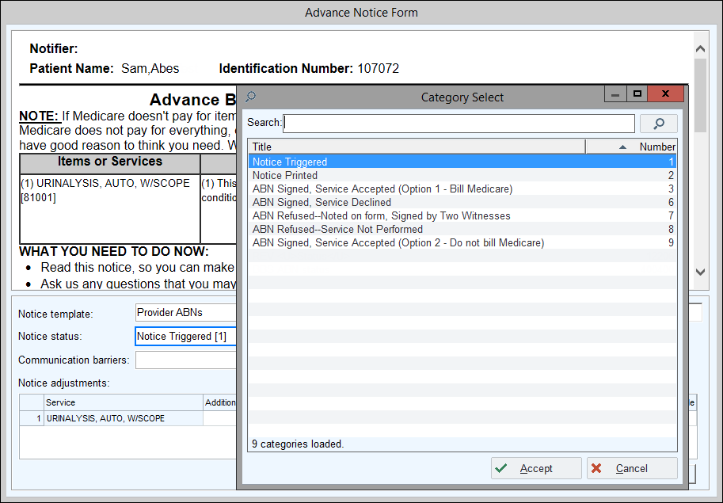
Users Can No Longer Mark ABNs as Void
Marking an unnecessary ABN as void is redundant because the system automatically voids ABNs when they are no longer required, such as when a clinician changes a diagnosis or order. Because of this, the ABN Voided status no longer appears as an option when clinicians click on the Notice status field.
Notes:
RN 734047

Slide 11
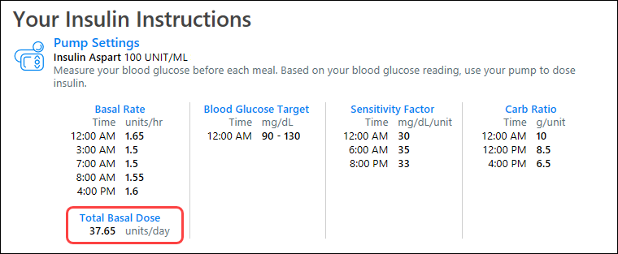
Total Basal Dose Now Appears in the Insulin Instructions Section of the AVS
Patients with insulin pumps now have easy access to their total basal dose in the Insulin Instructions section of the AVS.
Notes:
RN 736390

Slide 12
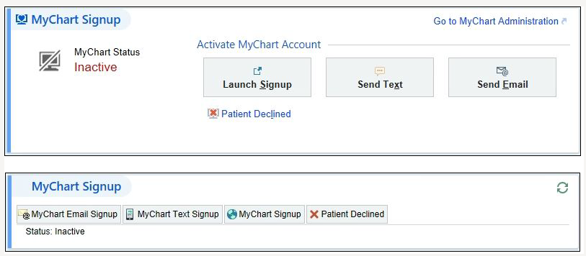
Quickly Activate Patients with Updated MyChart Signup Navigator Section
A patient's MyChart status and options for activating the patient for MyChart are now more prominent in the updated MyChart Signup navigator section. If you need to complete other tasks, such as setting up proxy access, you can easily go to the MyChart Administration activity through a link in the navigator section.
The updated MyChart Signup section (top) compared to the previous MyChart Signup section (bottom)
Notes:
RN - 735089

Slide 13
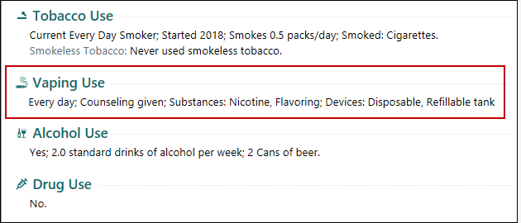
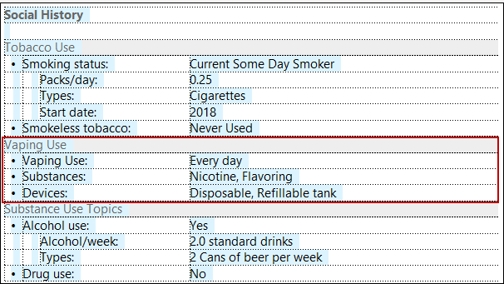
Vaping Information Appears Automatically in SmartTexts
Clinicians will see vaping information appear automatically in history SmartLinks that show tobacco and substance use. No longer will they need to use custom SmartLinks or SmartTexts to pull vaping information into their notes.
Notes:
765919 Need to check on verbiage – eCigarette?

Slide 14
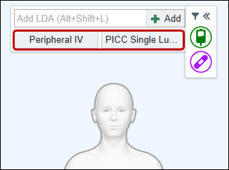
Add Commonly Used LDAs to the Avatar with Quick Buttons
Clinicians who place an LDA on the LDA Avatar can now add commonly used LDAs using quick buttons below the Add LDA field. Up to two quick buttons appear automatically, based on the most commonly placed LDAs in a clinician's login department.
Notes:
RN - 735718

Slide 15
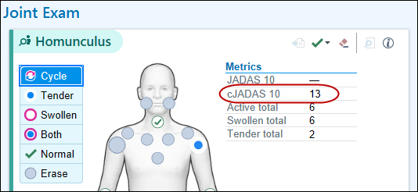
cJADAS Scores Appear for Pediatric Patients
cJADAS scores now appear alongside JADAS scores on the Joint Exam and in rheumatology SmartLinks and reports.
cJADAS on the homunculus
Notes:
RN - 739789

Slide 16
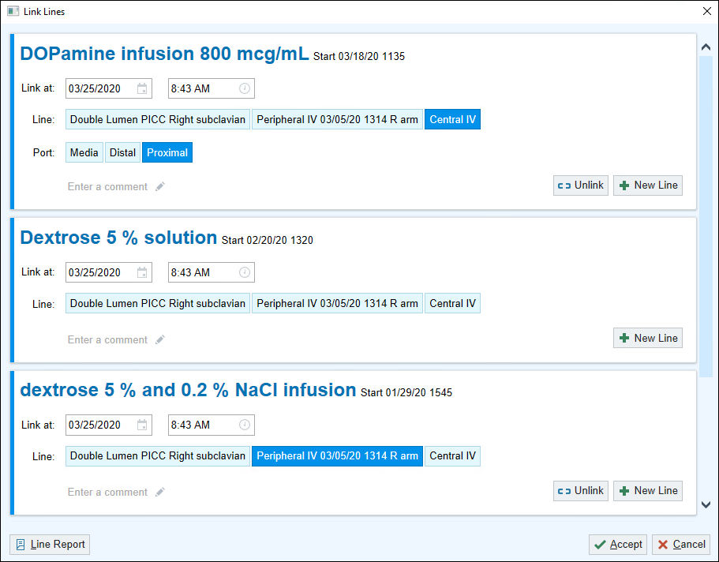
Line Linking Gets a New Look
Linking one or multiple lines to an order now happens on a single window. Add or remove lines for an order using new buttons within each order.
Notes:
RN - 733187

Slide 17
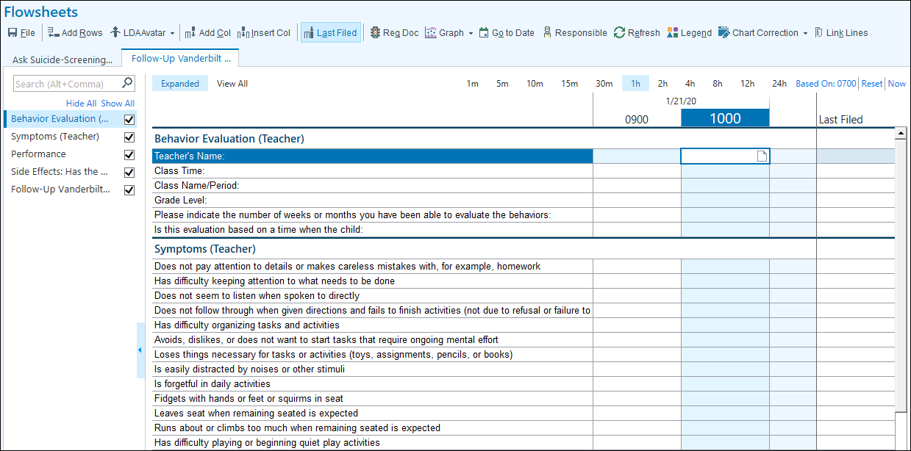
Screen Pediatric Patients for ADHD
The NICHQ Initial and Follow-up Vanderbilt Assessment screening tools for ADHD are now available in the Flowsheets activity. This allows for providers to document and trend this information in Epic. These assessments are also available to send as a patient questionnaire through MyChart for the patients’ parents or teachers to complete themselves.
Notes:
RN 754849

Slide 18
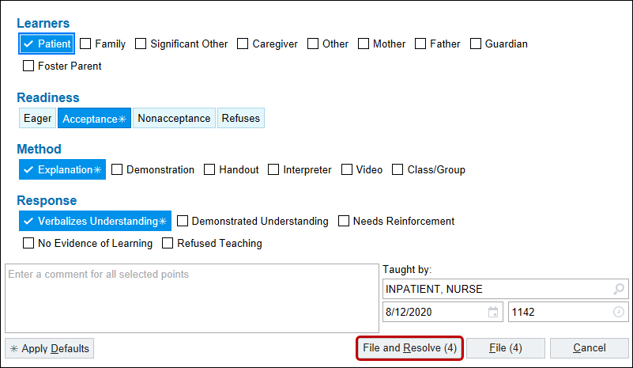
File and Resolve Education in One Click
Click File and Resolve to save your patient education documentation and resolve education points at the same time.
Notes:
RN 747188

Slide 19
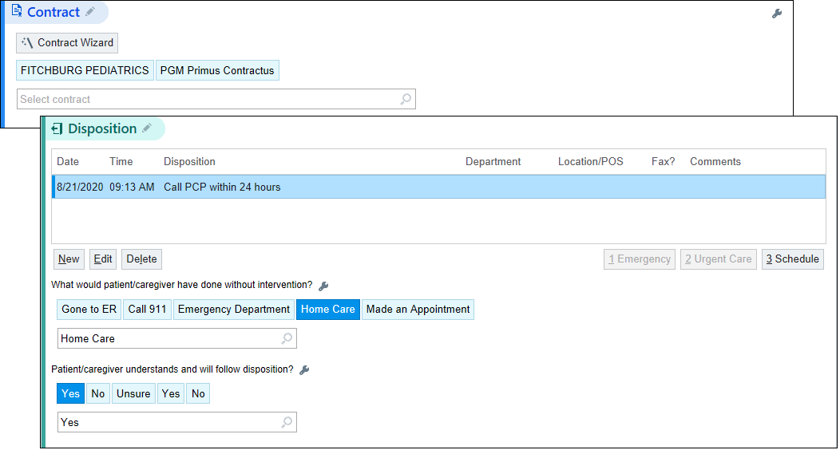
Save Clicks in Triage Calls and Telephone Encounters
Document and review Disposition information without clicking to open the section.
Notes:
RN 748661

Slide 20
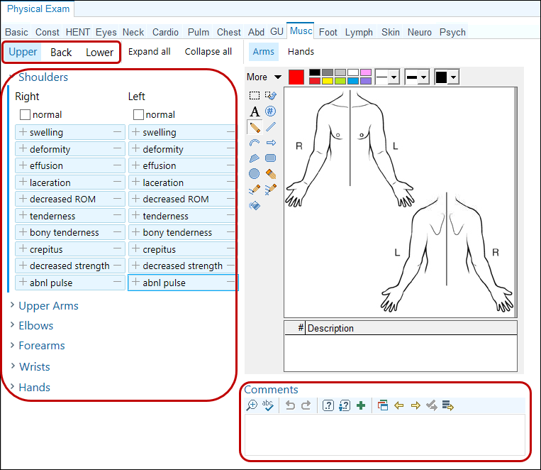
A New Musculoskeletal SmartForm
The following changes have been made to the Musculoskeletal Exam Form used for Physical Exams.
Region-specific tabs for evaluating a patient's upper extremities (Upper), back (Back), and lower extremities (Lower) have replaced the avatar. Each tab contains expandable sections for anatomical areas, like the Shoulders and Elbows sections in the Upper tab. In a given tab, clinicians can click Expand All to see all of their findings and click Collapse All to clean up their workspace.
The Comments SmartText box always appears.
The annotation images that appear to a clinician correspond to the tab that they have open.
In the Back tab, the findings in the Cervical section also appear in the Neck Exam SmartForm, and in the Lower tab, findings in the Feet section also appear in the Foot Exam SmartForm.
Amputation SmartData elements appear in their own section in the
Lower tab, making them easier to find.
Several findings, like pain, are no longer included as a symptom in
any tab because they are not considered observable physical exam
findings.
Notes:
RN - 733605

Slide 21
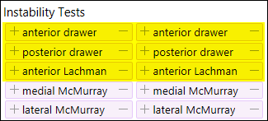
Document Additional Stability Tests in Knee and Ankle Forms
When documenting stability in the physical exam, you now have access to Lachman's and posterior drawer tests in the knee section, and anterior drawer tests in both the knee and ankle sections.
Notes:
RN 746802

Slide 22
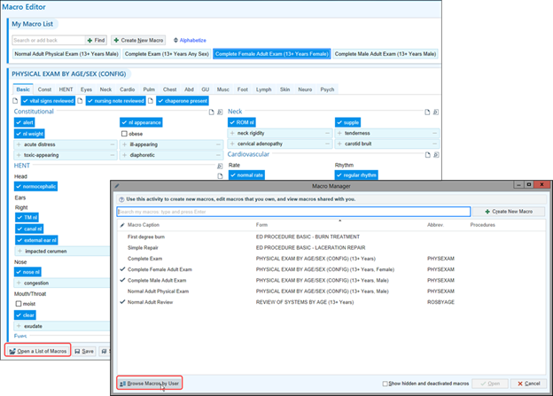
Take Charge with the Macro Editor and Manager
We've updated the Macro Editor's style to match other NoteWriter activities and added the Macro Manager. This feature allows you to search for a particular macro, as well as browse and add yourself as a user to macros created by other users without having to ask the owner to add you.
Notes:
RN 749030

Slide 23
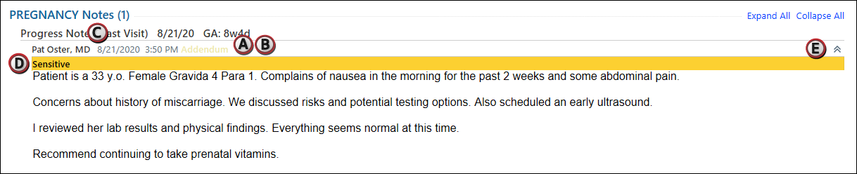
New Look and Feel for Prenatal Note Reports
Reports that show prenatal notes have a cleaner look and updated color coding:
The note status appears inline with the author, date, and time.
The same color-coding scheme used by standard notes to indicate note status now appears.
The date and time appear in a more subtle gray.
Only sensitive flags are highlighted to draw more attention to them.
Each note is collapsible, so you have more control over how much text appears on the screen.
Notes:
RN 748681

Slide 24
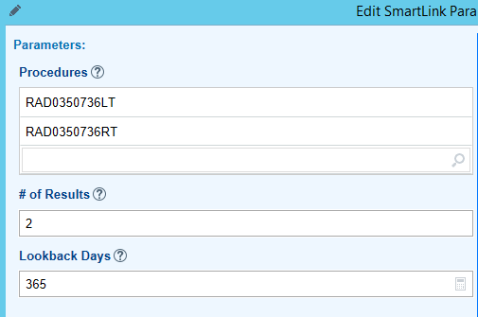
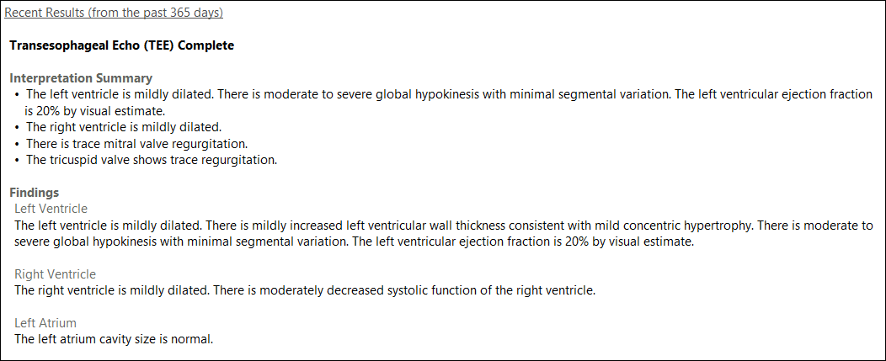
Easier-to-Read Imaging Results in Notes
If you want to show information from the most recent imaging result for a procedure in your notes, type .IMGRESULT. This link allows users to create their own list of imaging result links.
Any notes that already automatically include this information now show it in a cleaner format, making it easier to find the information needed more quickly. Additionally, the notes also now include multiple results.
Notes:
RN 751047

Slide 25
Prior Authorization

Slide 26
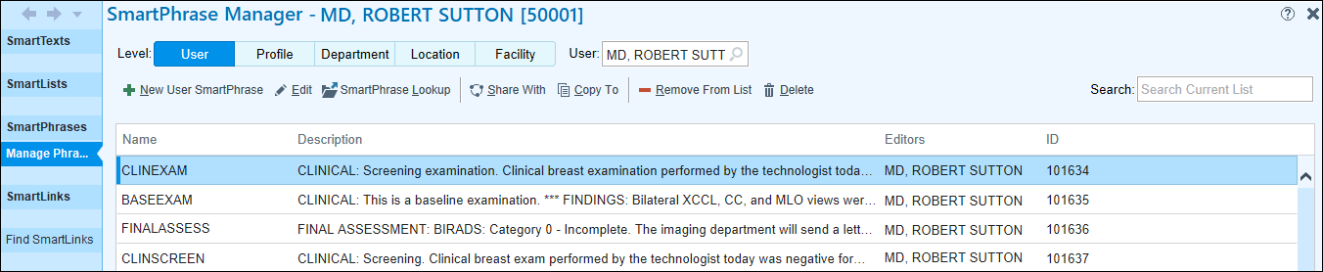
SmartPhrase Manager Has a New Look and Streamlined Workflow
It's now easier to search, share, and copy SmartPhrases
Some workflows are the same as before, although some buttons have been renamed
Notes:
RN - 733285

Slide 27
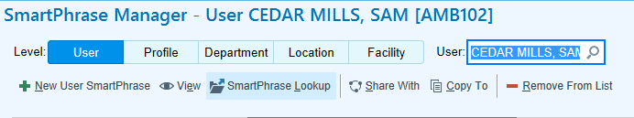
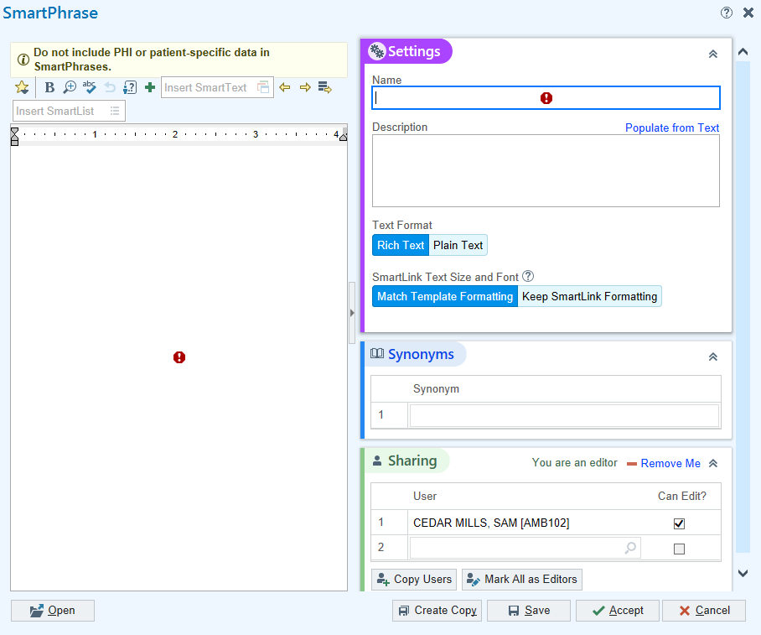
SmartPhrase Manager – How to Create a New SmartPhrase
Select the New User SmartPhrase button to create a new SmartPhrase.
Notes:
RN - 733285

Slide 28

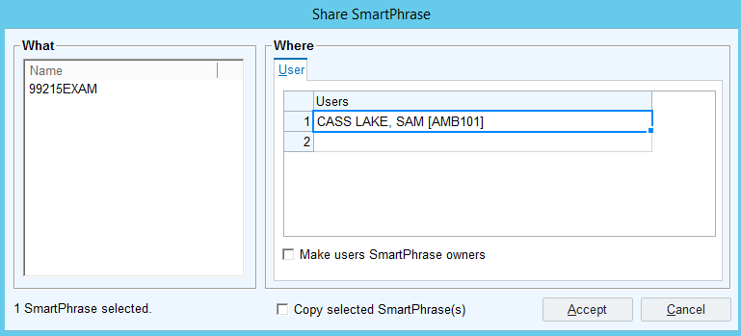
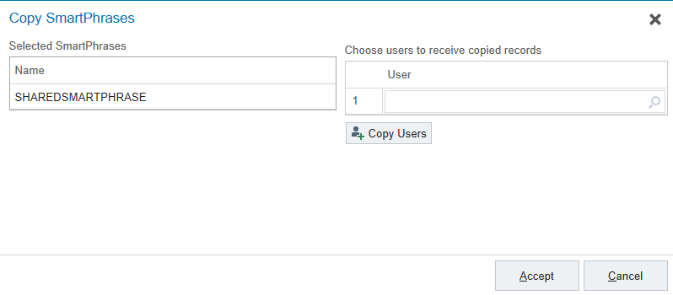
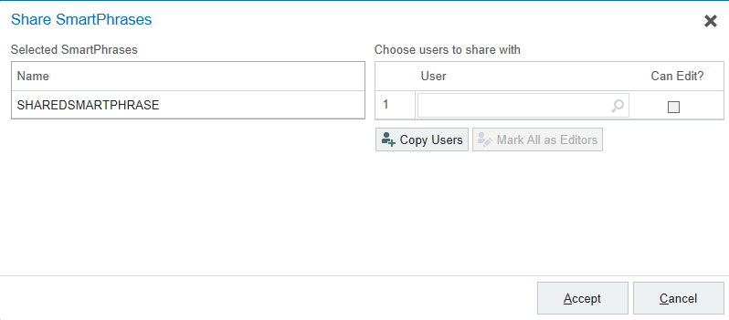
SmartPhrase Manager – Sharing and Copying SmartPhrases
Clinicians will locate other user SmartPhrases by searching in the User field in the Activity toolbar. When sharing or copying SmartPhrases there are now two separate buttons titled; Share With or Copy To. In the current version there is only the Share button.
Current Version Upgrade Version
Notes:
RN 733285

Slide 29
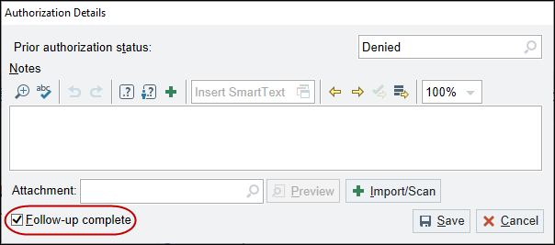
Decide Whether to Keep the Message for a Completed Prior Authorization
You can now control whether the system removes your message for a prior authorization when you complete it. Select the Follow-up complete check box to remove the message as before or clear it to save the message as a reminder to complete your follow-ups. Another option is to uncheck the 'Follow-up complete' check box in order to keep the message in the In Basket for any follow up needed.
Notes:
RN - 733826

Slide 30
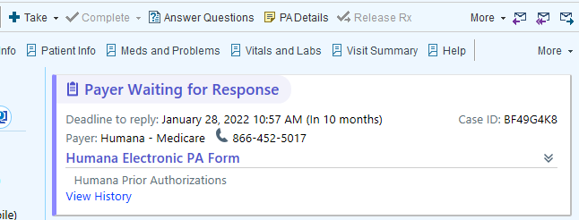
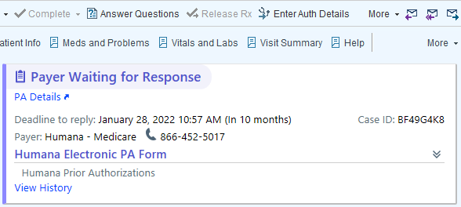
Use a Link to Open Prior Authorization Web Portals
To help keep actions next to relevant information, when a user needs to open the website for a network or payer to take action on a prior authorization, they can now click the PA Details link in the message body instead of a button above the message.
Also note that today the website opens within Epic, but after upgrade will open in an external web browser.
Old View
New View
Notes:
RN 748412

Slide 31
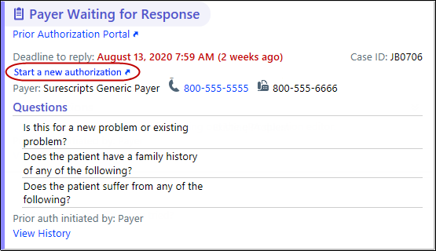
Restart Prescription Prior Authorizations After Questionnaire Deadlines Have Passed
If the deadline to respond to an authorization's question set has passed, you can now restart the authorization with a click instead of manually copying information into a new authorization.
Notes:
RN 754023

Slide 32
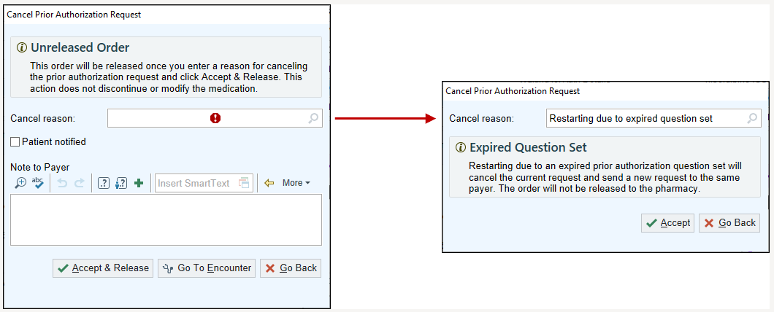
Cancel a Prior Authorization Request
If users need to cancel an authorization due to an expired question set, they can select a new cancel reason of Restarting due to expired question set. When they click Accept after selecting this reason, your system cancels the current authorization and then automatically generates a new request to give them a new deadline by which they need to submit answers.
Notes:
RN 754023

Slide 33
Social Determinants of Health

Slide 34
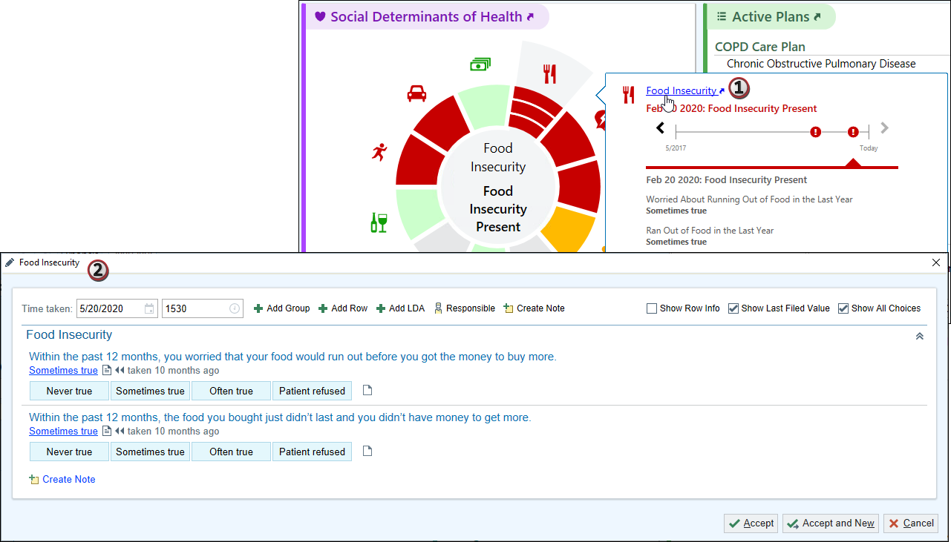
A New Way to Document SDOH
Social Determinants of Health (SDOH) functionality is moving from the History Activity to the Flowsheets Activity.
Users can still also access the questions from hovering over the SDOH information in the Storyboard or in Snapshot reports.
Notes:
RN - 735724

Slide 35
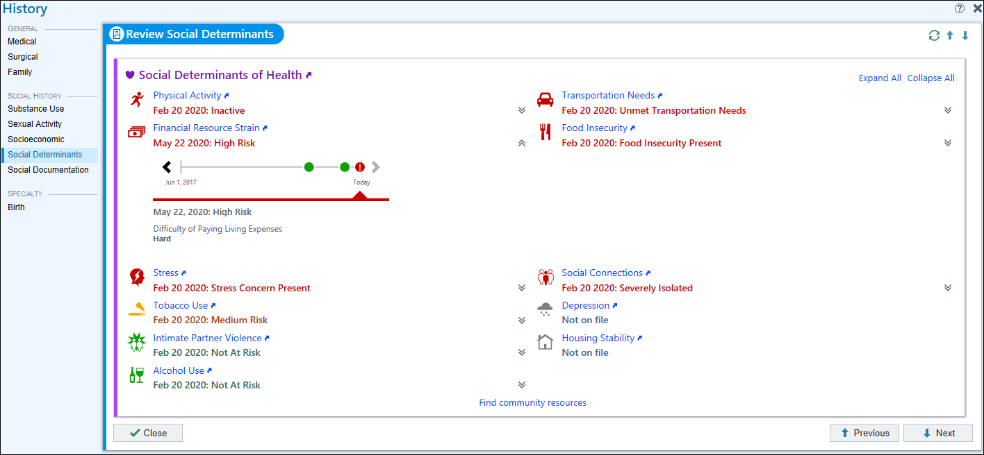
Review Past SDOH Information
Go to the History activity or the activity you added the Social Determinants review navigator section, to review the patient's past responses to the SDOH assessments. Expand each domain to see a timeline of the patient's past risk classifications for the domain. You can also click a domain name to document new responses
Notes:
RN - 735724

Slide 36
Health Maintenance

Slide 37
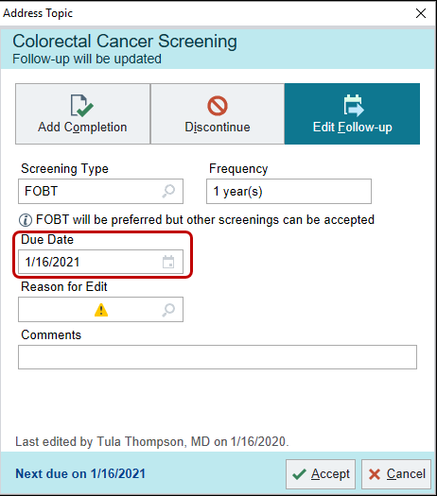
Set Patient-Specific Due Dates for Health Maintenance
Click Edit Follow-up from the Address Topic window to set a patient-specific due date for a Health Maintenance topic. For example, a patient who recently received a colonoscopy might now need fecal occult blood tests (FOBT) for colorectal cancer screening. You can specify that the patient should receive FOBT tests yearly and set the first due date to a year from now.
Notes:
RN - 731709

Slide 38
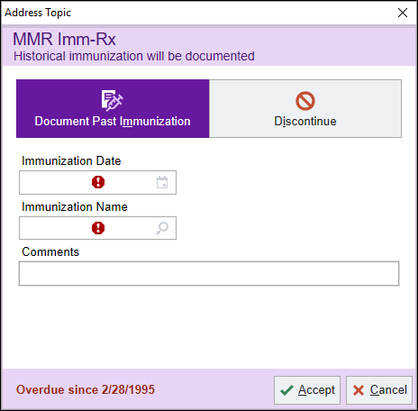
Document Historical Immunizations More Quickly
Save clicks by using the Address Topic window to document a historical immunization right from the Health Maintenance activity or Storyboard.
Notes:
RN - 732717

Slide 39
Treatment and Therapy Plans

Slide 40
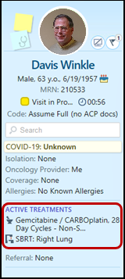
Easily See Treatment Plan and Therapy Plan Information in Storyboard
You can now see a patient's active treatment plan, therapy plan, radiation oncology episode, and blood and marrow transplant information at the top of Oncology Storyboards and choose whether to expand or collapse this information by default. To do so, hover over the section and click the chevrons that appear.
Notes:
RN - 735268

Slide 41
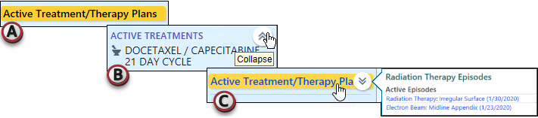
Easily See Treatment Plan and Therapy Plan Information in Storyboard (cont.)
You now have more control over how you see a patient's cancer treatment and therapy plan information in Storyboard. If a patient has an active treatment or therapy plan, you can expand the highlighted banner (A) show more details. Hover over the banner and click the chevron to collapse or expand the section (B). Your preference for expanding the section is then saved. If a patient has active radiation therapy episodes, treatments, or therapies, that information now appears when you hover over the section (C).
Notes:
RN - 743760

Slide 42
In Basket

Slide 43
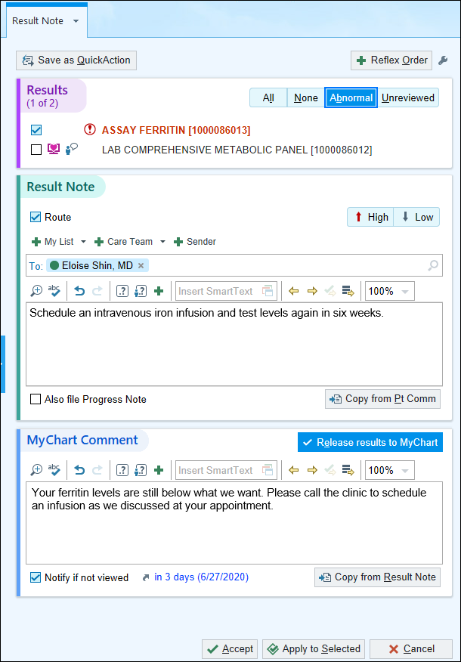
Result Note Finds a New Home in the Sidebar
To give you easier access to the information you need to write a result note, the chart now opens with your result note in the sidebar when you click Result Note from a Results In Basket message. You can route the result note, file a progress note to the chart, and release results to MyChart with additional comments in one smooth workflow.
Notes:
RN - 721434

Slide 44
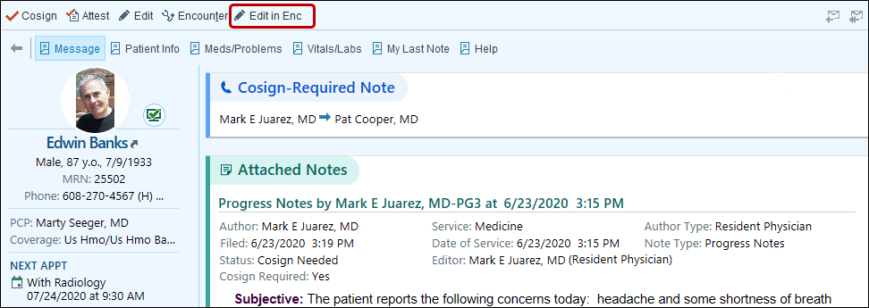
Edit in Encounter Available in the Sidebar
When you click Edit in Encounter to edit a note from In Basket, the note appears in the sidebar rather than in a separate window. This makes it easier to search the patient's chart for the information you need to complete your note.
Notes:
RN 742188

Slide 45
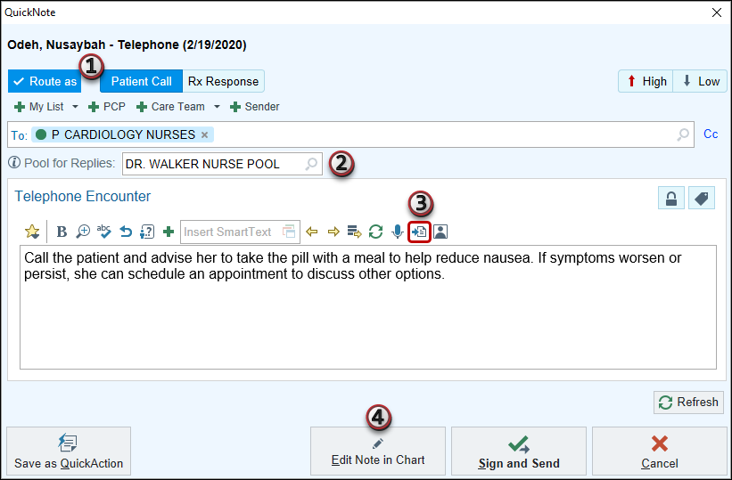
QuickNote Gets a Remodel
QuickNote has a new look and feel that's more consistent with the rest of In Basket. From a QuickNote, you can now:
Hide the routing section if you aren't routing the note by clearing the Route as option.
Enter a pool to receive replies instead of you in Patient Call and Rx Request messages.
Copy the text of a previous note into your QuickNote.
Pend your note and open the chart to continue it in a sidebar in Patient Call, Rx Request, and Rx Response messages if you can't find what you need in the message reports.
Notes:
RN - 732829

Slide 46
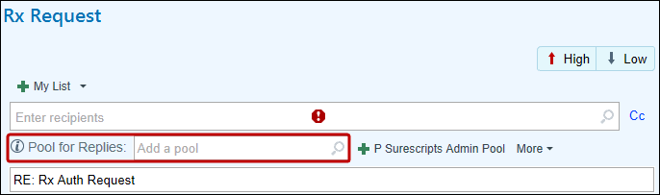
Send Message Responses to the Pool for Replies
When routing a patient call or prescription refill message, you can now direct responses back to a pool so that the message's follow-ups can be resolved more quickly. Look for the Pool for Replies field in In Basket, Card View, and the routing section of telephone encounters.
When your recipient clicks Reply, the pool you selected automatically appears in the recipient field.
Notes:
RN - 740310

Slide 47
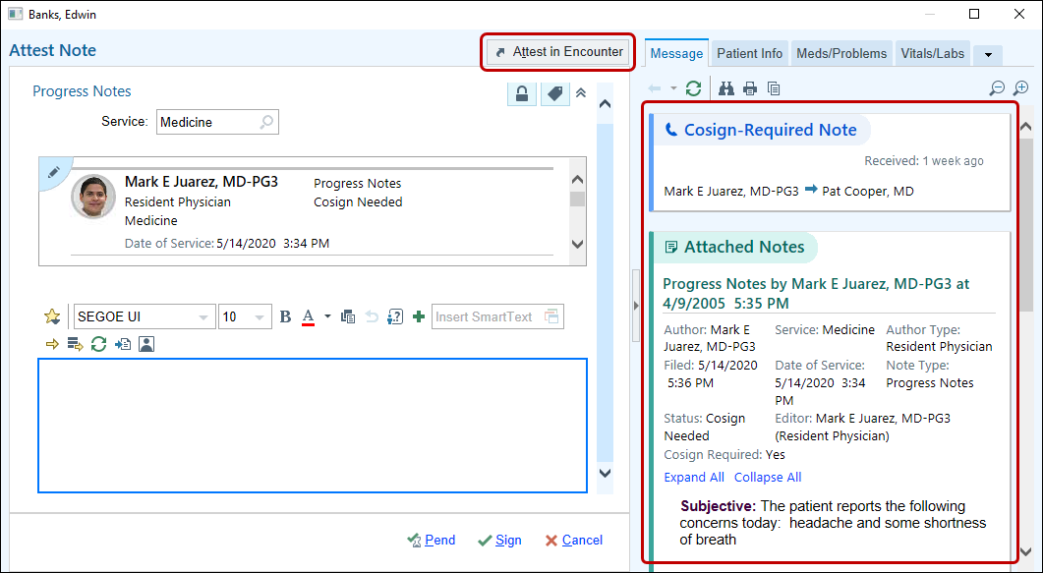
Write Notes from In Basket in a Clean, Focused Workspace
When you edit or attest to notes from In Basket, the note editor now appears in a floating window. Review In Basket reports to the right of your note, and if you need more information from the patient's chart, click Edit in Encounter or Attest in Encounter to pend your note and re-open it in the sidebar of the patient's chart.
Notes:
RN - 730307

Slide 48
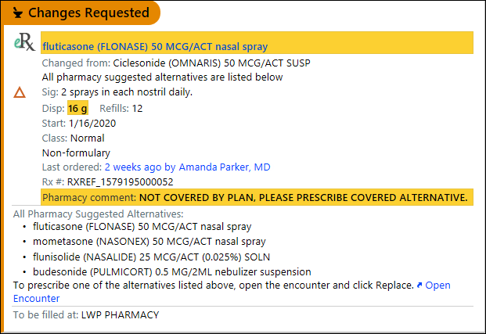
Review All Alternatives Suggested by the Pharmacy
When you receive a prescription change request from a pharmacy, you can now review all of the alternatives that the pharmacy suggested. If you're not sure that the primary alternative is the right choice, review the other alternatives to see if there's a better fit, then open the encounter and replace the medication.
Notes:
RN - 732141

Slide 49
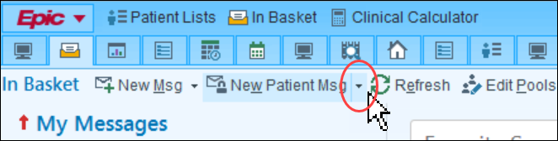
Just a Quick Click to Message a Patient
Send a new MyChart message to a patient from In Basket with fewer clicks; just set up a QuickAction for the Patient Message button. For example, you can set up a QuickAction to reply to a patient to tell them to schedule an appointment
Notes:
RN - 733616

Slide 50
Usability

Slide 51
Events in Scheduled Telephone Encounters Now Update Patient Status
Events such as checking in a patient or starting a visit now update a patient's status for all scheduled encounters, regardless of whether they are telephone encounters or in person.
This change allows users to more accurately follow the progress of telemedicine encounters and avoids labeling non-scheduled encounters with statuses that suggest a typical visit workflow.
Notes:
RN - 743049

Slide 52
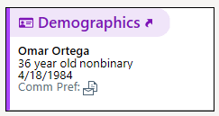
SnapShot Is Now Rich Text
Rich Text offer several advantages for users:
Visual consistency.
Convenient functionality.
Better accessibility.
Compatibility with Low Light.
All information in SnapShot is now shown in this style.
Notes:
RN - 745506

Slide 53
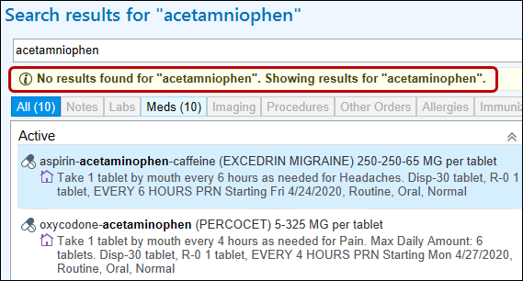
Showing Results For... Chart Search Finds Closely Matching Results
Chart Search now saves you time by accounting for typos in your search terms. If your misspelled search doesn't return any results, results for a closely matching term from the chart appear instead.
Notes:
RN - 732307

Slide 54
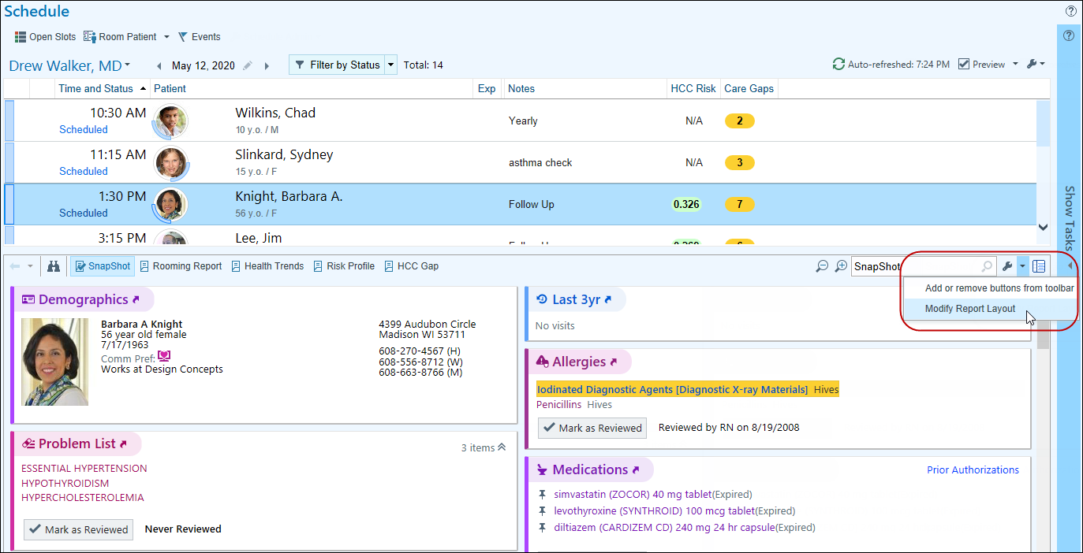
Rearrange Reports from Your Schedule
Select Modify Report Layout from the wrench menu, then drag and drop the report contents to rearrange them to your liking, just as you do in SnapShot and Chart Review. You'll see your changes wherever you view that type of report.
Notes:
RN - 734486

Slide 55
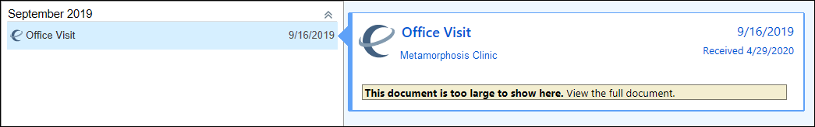
Chart Search Results Load More Quickly for External Documents
So that your search results can load more quickly, very large documents no longer show a preview in the Chart Search hover bubble. Click View the full document to open it in the document viewer instead.
Notes:
RN - 736212

Slide 56

Quick Disclosures Are Even Faster with an Updated Activity
The updated Quick Disclosure activity appears in a window instead of an activity tab. Click Me to add yourself as a recipient (A) and use the wrench icon to update the purpose and info released speed buttons (B).
Notes:
RN - 732801

Slide 57
A New Look for the Clinical Calculator
Four defined sections for the table of contents, formula, result, and remembered values make the Clinical Calculator more intuitive to use.
Notes:
RN - 732341

Slide 58

A New Look for the Group Documentation Encounter Selection Window
When you click Open Patient Lookup to add a patient to a group, the encounter selection window looks somewhat different, but does the same thing.
Notes:
RN - 736567

Slide 59

Search the Schedule in Immunization Clinic
In the Immunization Clinic activity, when working in a mass immunization setting, you can add a Select a Scheduled Patient button to find the patient using patient lookup.
Clicking Select a Scheduled Patient (1) opens the Patient Lookup window (2)
Notes:
RN - 771978

Slide 60

Add SmartPhrases to Your Notes Using SmartLists
To speed up your documentation, you can now use SmartLists to add SmartPhrases to your notes and other documentation in SmartTool-enabled text boxes in Hyperspace, Haiku, and Canto. For example, you might create a SmartList that includes all of the SmartPhrases you use to document your most commonly performed procedures so that you can quickly pull in any of the SmartPhrases by adding the same SmartList.
Notes:
RN - 736369

Slide 61

Hover to Discover New Demographics Information in Storyboard
You now have easy access to more demographics information when you hover over a patient's name at the top of Storyboard in a clinical and HIM (1) or patient access (2) context.
Look for these new items, if they're documented for the patient:
Patient Contact
Time of Birth, until a baby is one month old
Written and Spoken Language (clinical and HIM only)
Unit (clinical and HIM only)
Race and Ethnicity (clinical and HIM only)
Notes:
RN - 734830

Slide 62

Hey Epic!
Show Me What You Can Do in Hyperspace
Hey Epic!, the Epic voice assistant, is now available in Hyperspace. Uses commands to look up information in a patient's chart. To activate Hey Epic! from anywhere in Hyperspace, a clinician can say "Hey, Epic!" into their microphone. They can also open Hey Epic! by pressing Ctrl+/ or clicking the microphone icon in the Hyperspace toolbar.
To see a list of available commands, a clinician can say "Hey Epic! what can you do?"
Notes:
RN - 745626

Slide 63

It's Now More Obvious When You're Viewing Information for a Deceased Patient
When you open an In Basket message or the chart for a deceased patient, the circle containing the patient's photos or initials is now grayed out and surrounded by a black border.
Notes:
RN - 746504

Slide 64

See the Most Recent Lab Results Faster
Lab Spotlight sections summarize the most recent lab results and components, like Hemoglobin A1C or WBC, for over a hundred different labs.
Notes:
RN 748074

Slide 65

Same-day Appointments Now Shows Visits That Are in Progress or Complete
The Same-day appointments print-group now shows information for any other appointments scheduled for the patient on the same day as the encounter a user is viewing. The information provided includes the encounter date and time, provider, department, and location. It also shows visits that are in progress or completed
Notes:
RN – 747539

Slide 66

Simpler Searches for Allergies
When you're adding a new allergy, search results appear in a simple drop-down list rather than a separate window. The Full Search check box, which you use to include uncommon allergies in your search, appears right next to the search bar.
Notes:
RN - 744122

Slide 67

Care Everywhere Documents Have a Fresh Look and New Workflows
To align more closely with Chart Review, we've updated the appearance of Care Everywhere documents. For example, most action buttons now appear in the report toolbar. Also, you can use the wrench icon to modify your preferred section order.
Notes:
RN 750554

Slide 68



Mark a Message Filter as a Favorite in Card View
Easily apply a frequently used message filter in Card View by marking the filter as a favorite. Optionally, select the type of message you want to view. Then, apply a filter and click the star. Going forward, click the favorite filter icon to quickly see the matching messages.
A clinician applies a filter to find all patient call messages that have pending orders they need to sign.
This clinician commonly uses this filter, so they click the star icon to favorite the filter. The favorite filter icon appears in the menu, showing how many patient call messages have pending orders.
The clinician clicks the favorite filter icon to see only the patient call messages that have pending orders.
Notes:
RN 746503

Slide 69

Updated Keyboard Shortcuts in the Immunizations Activity
The following buttons have new keyboard shortcuts:
Notes:
RN 747726

Slide 70

Easier Searching for Immunizations
Search for part of an immunization name to find all immunizations that include your search term. For example, enter hib to find all vaccines that include Hib. This function can be utilized when searching to add a historical vaccine.
Notes:
RN 751103

Slide 71

Keep an Eye on the Number of Patients on Clinic Track Board Views
Clinic Track Board users can see the number of patients for the current day appears in parentheses on each view button at the top of the Clinic Track Board, whether that view is currently selected or not. This makes it easier for Clinic Track Board users to remain aware of the current and upcoming volume of patients for the current day.
The number of patients for the current day appears on each view button at the top of the Clinic Track Board.
Notes:
RN – 745551

Slide 72

See New and Active Infections in SlicerDicer
Use the Active Infections and New Infections filters to incorporate infection information into your research.
Notes:
RN 757308

Slide 73
Order Management

Slide 74

Only Ordered Labs and Other Procedures Appear in Visit Diagnoses
To simplify visit diagnoses print groups that show orders, only orderable procedures now appear.
Print group 56214 (A) before this change and (B) after
Notes:
RN - 736596

Slide 75

A New Look for Diagnosis Association
The windows you use to associate diagnoses and problems with orders have a new modern look. The workflow hasn't changed, but the windows look a little different and you might notice that fields appear in a slightly different order than you're familiar with.
Notes:
RN - 733921

Slide 76
Healthy Planet

Slide 77

Risk Score Hover Bubbles Now Show the Score Trend
Hover over risk scores in Reporting Workbench reports to see the score's trend.
Notes:
RN - 738079

Slide 78

Clearer Guidance for Starting Care Companion Medication Reminders After Discharge
When you want to start medication reminders for Care Companion after an admitted patient is discharged, select Auto Start Med Reminders After Discharge (formerly named Start Med Reminders) in the Patient To Do List activity (A).
If the patient has one or more medications for which reminders cannot be automatically started after discharge, a banner appears to let you know (B). These medications also now appear in the Medications section instead of the Medications (Automatically Start After Discharge) section (C).
Notes:
RN - 742764

Slide 79

Updated Hepatitis C Screening Registry Metric to Align with USPSTF Recommendations
The Preventative Care Gap Score will now show the Hepatitis C Infection (HCV) screening for patients ages 18-79. Previously this was only shown for patients who were born between 1945-1965.This information can be found in the Preventative Care Gap risk score section on the Risk Profile Report displayed on the Snapshot Activity or Sidebar Reports.
Notes:
RN - 742164

Slide 80
Medications and Orders

Slide 81

Manage Your User SmartSets and Order Sets More Easily
There are some quality-of-life changes for managing your user SmartSets or Order Sets:
Favorite and My User SmartSets or Order Sets appear in expanded sections.
Quickly mark or unmark SmartSets or Order Sets as favorites by clicking the star icon.
Remove your My User SmartSet or Order Set versions with the new Delete Version button.
Notes:
RN - 745915

Slide 82

Warfarin Anticoagulation Tracking Navigator Gets a New Look
More easily review anticoagulation information with the new layout of the Warfarin Anticoagulation Tracking section. View more dosing information (A), select the None given check box (B) when a patient isn't given dosing instructions, and use the new Follow-Up section (C) to set priority, specify the date of the next INR, and resolve the episode.
The Edit Episode Information link can be found in the top-right corner of the screen again and not just in the Patient Storyboard.
Please review updated Anticoagulation Tip Sheets
Notes:
RN - 745427

Slide 83

View Warfarin Tablet Counts and Weekly Totals in the Calendar
When reviewing the calendar in the Warfarin Anticoagulation Tracking navigator section, select the Tablet Counts check box to view the tablet count for each day. To view the total milligrams prescribed per week, select the Weekly Totals check box.
Please review updated Anticoagulation Tip Sheets
Notes:
RN - 745427

Slide 84

A New Look for Selecting Care Team Recipients
When entering and routing External INR results through the Warfarin Anticoagulation Tracking navigator section, clicking Care Team opens a new window for selecting recipients (patient must have more than one Care Team member for this to work). To use this window:
Click a recipient's line to select recipients individually (A). Selected recipients appear in the right sidebar (B).
Click a selected recipient's line, or click the X next to their name (C) to deselect recipients individually.
Click Select All to select all recipients (D). When all recipients are selected, the Select All button becomes the Remove All button.
Notes:
RN 749477

Slide 85

A New Look When You Edit Multiple Unsigned Orders
When you click Edit Multiple to update your unsigned orders, you'll notice that the form has a fresh look, and frequency and date-related fields have moved. The grouping of orders on the left side has also been updated.
Notes:
RN 723399

Slide 86
Care Everywhere

Slide 87

New Look and Features for the Care Everywhere Outside Records Activity
The Care Everywhere Outside Records activity has been redesigned to make it easier for you to access the most relevant patient information and to be more consistent with Chart Review.
Tip Sheet: Review a Patient's Outside Records
Notes:
RN 747752

Slide 88


Mark Outside Information As Reviewed Continued
If a tab contains outside information that needs review, a folder icon with an arrow pointing into it, the same icon that appears in Storyboard, now appears on the tab. After a clinician has reviewed the information, a check mark appears on the folder icon. If your organization receives new information from an outside organization after information on a tab has been reviewed, for example, because a clinician requested updates to a patient's outside record, the check mark disappears.
The reconciliation banners that notify clinicians about outside information are also updated to indicate that new information is available.
Notes:
RN 747836

Slide 89

Streamlined Workflows in the Request Outside Records Activity
You can use a new checkbox next to the Favorites header in the Choose Organizations to Query section to query all your favorited organizations at once. When searching for organizations, you can now click forward and backward arrows to navigate between pages. The Collect Authorization Button is now called View Authorization. There is a Cancel Request and a Cancel All Request button to allow for greater flexibility when choosing which query to cancel.
Notes:
RN 746523

Slide 90

More Intuitive Location for the Discard Remaining Button in the Reconcile Outside Information Activity
To align the Discard Remaining button with the other discard buttons in the Reconcile Outside Information activity and to reduce scrolling, the Discard Remaining button now appears on the left side of the activity instead of on the right side.
Notes:
RN 749097

Slide 91
History and Pedigree

Slide 92

Include Fertility Information in Pedigree
In the Pedigree sidebar, you can document fertility statuses for a patient or their relatives, along with detailed notes to further inform your recommendations. Status is indicated by the standard notation for No Children By Choice (A) and Infertile (B) in the diagram. When a fertility status note is included, the note icon appears next to the patient or relative.
Notes:
RN 746438

Slide 93

More Family History, Fewer Clicks
Some enhancements have been made to the Family History section to increase efficiency, including:
Patient information appears at the top of the section instead of the bottom. A Details button is available for all patients.
Comments are visible without extra clicks.
More room for names and notes avoids scrolling or clicking for details.
Negative Hx appears in a separate table below the family members to reinforce the distinction between shared family conditions and pertinent family negatives.
Problems are added and edited with a new menu instead of the previous window.
Notes:
RN 748827

Slide 94

Pedigree Information is Available in Family History
Click the pencil next to a family member (A) to update information such as adoptive parents, twins, and chart linking. You can see similar information for the patient by clicking Details (B).
Notes:
RN 748827

Slide 95
Obstetrics

Slide 96

Visual Cues Help You Review Graphs in the Bilirubin Activity
Use the following visual cues to assist with reviewing bilirubin nomograms:
Shaded regions and patterned lines show the thresholds of different risk zones.
Tooltips show which risk zone a point is graphed in and the bilirubin levels that require treatment for each neurotoxicity risk level.
Notes:
RN 745054

Slide 97

A Newly Organized Pregnancy Overview and Plan
To make it easier for you to quickly find information in the Pregnancy Overview and Plan section, the fields are now organized into the following sections:
Pregnancy
Delivery Plans
Post-Delivery Plans
Notes:
RN 747686

Slide 98

An Updated Look for the Dating Navigator Section
When the Dating navigator section is open:
  A. The precision values appear on buttons instead of next to radio buttons.
  B. If a row is not filled out and does not have an EDD listed in the Select EDD column, the radio button does not appear for that row.
When the Dating navigator section is closed:
  C. The data appears more evenly spaced out in a table view.
  D. The precision value appears in parentheses next to the basis.
Notes:
RN 753949

Slide 99
MAR

Slide 100

A Fresh Look for the MAR
Complete your documentation faster with a fresh look for the MAR Administration form.
Tip Sheet: The MAR, Modernized
Notes:
RN 745903, 752385

Slide 101

MAR Warnings Get in Line
Warnings appear below the field that caused them to appear so you can more quickly resolve them. Scan or document all the medications you're documenting, resolve any warnings, and then administer the medications.
Click Go to Next at the bottom of the Administration form to go to the next warning or required flowsheet row to complete.
Tip Sheet: The MAR, Modernized
Notes:
RN 745903, 752385

Slide 102

See the Status of Details Sent to a Pump
Choose the pump and the channel with the rest of your documentation instead of in a separate window. If the pump wasn't disassociated from a previous patient, the system automatically resolves that association to save you time.
Then, when you send outgoing details to a pump, you can see more real-time information about what's happening with the pump communication.
Tip Sheet: The MAR, Modernized
Notes:
RN 745903

Slide 103

Clearer Information for Selecting an Administration
When you scan a medication that has multiple administrations to document, the Select an Action Time (formerly Select an Administration) window appears.
In the updated window, there are buttons for all of the available administrations to document, with the most recent past action and the closest future action at the top because they're the ones you're most likely documenting.
Tip Sheet: The MAR, Modernized
Notes:
RN 745903, 752385

Slide 104
Hey Epic!

Slide 105

Hey Epic! What's New?
Hey Epic! shows a list of new or modified commands the first time you open it after an Epic upgrade. You can also ask "Hey, Epic! What can I say?"
Notes:
RN 748749

Slide 106
Hey Epic! Show Me More Stuff
At a workstation, ask Hey Epic! to bring up more pieces of information in a patient's chart. For example, try saying "Hey, Epic! Show me..." one of the following:
The problem list
The allergy list
Demographics
Patient reminders
Future appointments
The reason for visit
The infection and isolation status
MyChart status
Intake and output
Immunizations
There are many other pieces of information you can tell Hey Epic! to show. For a complete list of commands, say "Hey, Epic! Help."
Notes:
RN 748743

Slide 107

Hey Epic! Sign My Visit!
At a workstation, in outpatient visits, say "Hey Epic! Sign the visit," and the visit is signed. If there are outstanding tasks, the sidebar opens to show you what needs to be done before you can sign. Hey Epic! can't sign the visit during pre-charting, for a hospital admission, or in the emergency department.
Notes:
RN 748912

Slide 108
New Shortcuts for the To Do Sidebar and In Basket Folders
Use the following new keyboard shortcuts to decline a deficiency or mark it as already done in the To Do sidebar and In Basket's Chart Completion, Cosign-Clinic Orders, and Home Care Orders folders:
Alt+L = Decline
Alt+Y = Already Done
Notes:
RN 746099

Slide 109

A New Look for In Basket Letter Messages
The In Basket Send a Letter and its printing options have a modernized appearance. Users can now mark the priority of the message to make the importance of the message clear to recipients. Messages automatically have a routine priority. To raise or lower the priority, click the High or Low priority buttons.
The Print On field now says Delay Sending Until. To send the message immediately, users should leave this field blank.
Notes:
RN - 750786

Slide 114
.

Slide 115
.

Slide 116
The End
For further information, please visit our CentraCare and AffiliateNet websites.

Slide 117


