Slide 1

Cy21 ambulatory Evaluation &
Management rules: fireside chat #2 data discussion
Jessie Roske, MD
Medical Director for Clinical Documentation Integrity
Sue Stein, CPC Compliance Manager
Notes:
AMV

Slide 2
Ambulatory E&M is changing January 1, 2021
This is a supplement to previous educational workshops that took place Nov/Dec and also available recorded
Notes:
JR

Slide 3
Medical Decision Making (MDM) Elements
2 of 3 of these elements must be met for the given level
MDM Level | 1. Number and complexity of problems addressed | 2. Amount/ complexity of data reviewed | 3. Risk | As seen in
Straightforward | Straightforward | Minimal | Minimal | New Patient Level 2 - 99202 Established patient level 2 – 99212
Low complexity | Low/uncomplicated | Limited | Low | New Patient Level 3 - 99203 Established patient level 3 – 99213
Moderate complexity | Moderate/complicated | Moderate | Moderate | New Patient Level 4 - 99204 Established patient level 4 - 99214
High complexity | Severe/threat to life or function | Extensive | High | New Patient Level 5 - 99205 Established patient level 5 - 99215
Notes:
JR

Slide 4
Ambulatory Element 2 of MDM: Data Reviewed
A. Tests
Ordering of each unique test
Review of result of each unique test
Review of prior notes from each unique source
B. Information from an independent historian
C. Tests: Next level Independent interpretation of test
D. Another provider Discussion of a test result or management plan with another provider (in another specialty)
MDM Level | 2. Data | As seen in
Straightforward |  | New Patient Level 2 - 99202 Established patient level 2 – 99212
Low complexity |  | New Patient Level 3 - 99203 Established patient level 3 – 99213
Moderate complexity |  | New Patient Level 4 - 99204 Established patient level 4 - 99214
High complexity |  | New Patient Level 5 - 99205 Established patient level 5 – 99215
Take homes:
Test points (A ) max out
Some other data type is required for level 5
3. Data types B , C , D are highly impactful
4. Use the smartlist to get credit for the work you do
Notes:
JR

Slide 5

Test interpretation is super hard and controversial

Slide 6
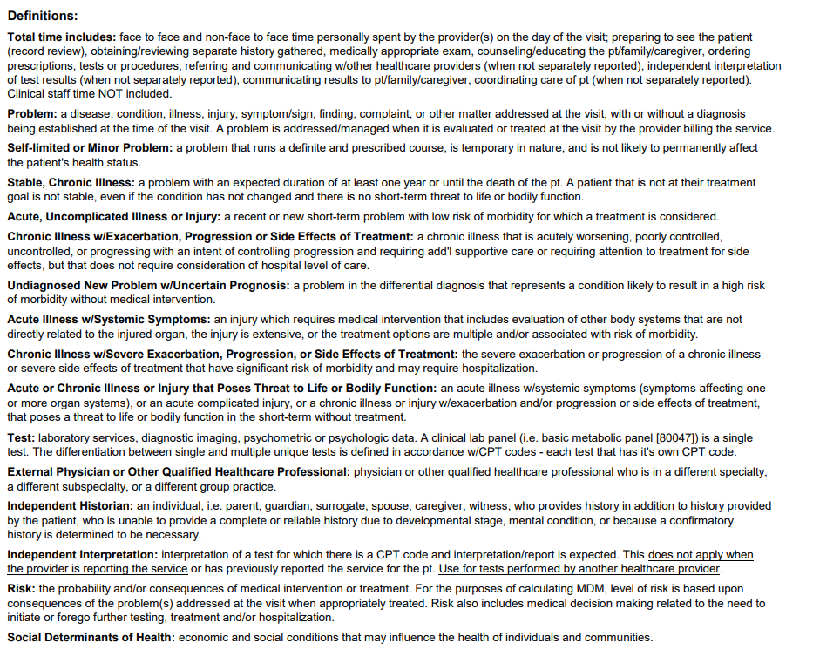
Back side of handout has definitions
Notes:
JR

Slide 7
Grey areas: tests (review and summarize records)
In the clinic, credit for review and summarize of records from each unique source:
  Of an external health care system
  NEW: Of a external specialty (even within the same system)
Must summarize
Notes:
JR

Slide 8
How does one consider my work in relation to a test?
Levels of test evaluation:
Order
Review
Personally interpret
Discuss a test result with another provider

Slide 9
How does one consider my work in relation to a test?
Levels of test evaluation:
Order
Review
Personally interpret
Discuss a test result with another provider

Slide 10
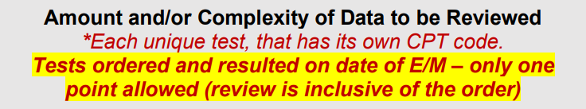
Test order and review
(subject to adjusted interpretation)
It is indeed explicitly separate to order a test and review a test
  Seems odd: In general E&M does not allow "double dip"
Current interpretation:
  Ordering tests means carrying it all the way through including to reviewing result
  Considering review separately means giving you credit for reviewing a test someone else ordered (like a cardiology visit, ER visit, another health system etc)
Notes:
JR

Slide 11
How does one consider my work in relation to a test?
Levels of test evaluation:
Order
Review
Personally interpret
Discuss a test result with another provider

Slide 12
Test personal interpretation
(subject to adjusted interpretation)
Interpretation of a test for which there is a CPT code and interpretation/report is expected.
You cannot double dip: This does not apply when the provider is reporting the service or has previously reported the service for the patient.
Use for tests performed by another healthcare provider external to you/your group where you added something unique to the story
Note:
Simply looking at a test ≠ interpretation
Notes:
JR

Slide 13
Tests have multiple components
Global charge
Technical component: Doing the test
Professional component: Interpretation (by Pathology – path/cytology, Radiology - imaging, Cardiology - echo, Neurology – EEG, Pulmonology – PFT, Sleep Medicine – polysomnography, EKG can be anyone)
Independent interpretation (level C)
One can provide an informal additional interpretation (ex. primary care looking at EKG in real time or surgery looking at a CT scan before or after a read) and receive credit towards MDM if:
  neither you nor your group are billing the professional component of the test
    You and your group are one
    NOTE: If the department is contracted to bill for a professional component completed by another group (i.e., Radiology, Cardiology, etc.), one cannot receive credit
    one could receive credit for informal interpretation and the order of test
    Documentation must support the order and informal interpretation

Slide 14
Take home point:
Within a professional group, you get credit once for interpreting (either formally or informally/level C)
If your group interpreted the test formally, one could still take credit for reviewing the results – if the test was ordered by another group (level A)
  Remember: if your group ordered a test, your group is responsible for reviewing it, without double dip credit (review is inclusive of ordering– you carry the test all the way through)

Slide 15
examples

Slide 16
Example #1:
  Internal Medicine Dr. A orders a chem-8 and CBC in advance of a visit, Internal Medicine Dr. A reviews the results at the visit:
A. Tests
Ordering of each unique test
Review of result of each unique test
Review of prior notes from each unique source
B. Information from an independent historian
C. Tests: Next level Independent interpretation of test
D. Another provider Discussion of a test result or management plan with another provider (in another specialty)
MDM Level | 2. Data | As seen in
Straightforward |  | New Patient Level 2 - 99202 Established patient level 2 – 99212
Low complexity |  | New Patient Level 3 - 99203 Established patient level 3 – 99213
Moderate complexity |  | New Patient Level 4 - 99204 Established patient level 4 - 99214
High complexity |  | New Patient Level 5 - 99205 Established patient level 5 – 99215
x2
Notes:
JR

Slide 17
Example #2:
  Internal Medicine Dr. A orders a chem-8 and CBC at a visit, Internal Medicine Dr. A reviews the results at the next visit:
A. Tests
Ordering of each unique test
Review of result of each unique test
Review of prior notes from each unique source
B. Information from an independent historian
C. Tests: Next level Independent interpretation of test
D. Another provider Discussion of a test result or management plan with another provider (in another specialty)
MDM Level | 2. Data | As seen in
Straightforward |  | New Patient Level 2 - 99202 Established patient level 2 – 99212
Low complexity |  | New Patient Level 3 - 99203 Established patient level 3 – 99213
Moderate complexity |  | New Patient Level 4 - 99204 Established patient level 4 - 99214
High complexity |  | New Patient Level 5 - 99205 Established patient level 5 – 99215
Notes:
JR

Slide 18
Example #3:
  Internal Medicine Dr. A orders a chem-8 and CBC at a visit, Internal Medicine Dr. B reviews the results at the follow up visit:
A. Tests
Ordering of each unique test
Review of result of each unique test
Review of prior notes from each unique source
B. Information from an independent historian
C. Tests: Next level Independent interpretation of test
D. Another provider Discussion of a test result or management plan with another provider (in another specialty)
MDM Level | 2. Data | As seen in
Straightforward |  | New Patient Level 2 - 99202 Established patient level 2 – 99212
Low complexity |  | New Patient Level 3 - 99203 Established patient level 3 – 99213
Moderate complexity |  | New Patient Level 4 - 99204 Established patient level 4 - 99214
High complexity |  | New Patient Level 5 - 99205 Established patient level 5 – 99215
Notes:
JR

Slide 19
Example #4:
  Patient has a chem-8 and CBC in the ER, Internal Medicine Dr. A reviews the results at the follow up visit:
A. Tests
Ordering of each unique test
Review of result of each unique test
Review of prior notes from each unique source
B. Information from an independent historian
C. Tests: Next level Independent interpretation of test
D. Another provider Discussion of a test result or management plan with another provider (in another specialty)
MDM Level | 2. Data | As seen in
Straightforward |  | New Patient Level 2 - 99202 Established patient level 2 – 99212
Low complexity |  | New Patient Level 3 - 99203 Established patient level 3 – 99213
Moderate complexity |  | New Patient Level 4 - 99204 Established patient level 4 - 99214
High complexity |  | New Patient Level 5 - 99205 Established patient level 5 – 99215
x2
Notes:
JR

Slide 20
Example #5:
  Internal Medicine Dr. A orders an EKG and Internal Medicine Dr. A personally informally interpret it for the visit that day, knowing cardiology will have a professional fee for the formal read
A. Tests
Ordering of each unique test
Review of result of each unique test
Review of prior notes from each unique source
B. Information from an independent historian
C. Tests: Next level Independent interpretation of test
D. Another provider Discussion of a test result or management plan with another provider (in another specialty)
MDM Level | 2. Data | As seen in
Straightforward |  | New Patient Level 2 - 99202 Established patient level 2 – 99212
Low complexity |  | New Patient Level 3 - 99203 Established patient level 3 – 99213
Moderate complexity |  | New Patient Level 4 - 99204 Established patient level 4 - 99214
High complexity |  | New Patient Level 5 - 99205 Established patient level 5 – 99215
Notes:
JR

Slide 21
Example #6:
  Cardiologist Dr. C orders an EKG and Cardiologist Dr. C personally interprets it, but know Cardiologist Dr. D (partner) will be get the professional component of the EKG
A. Tests
Ordering of each unique test
Review of result of each unique test
Review of prior notes from each unique source
B. Information from an independent historian
C. Tests: Next level Independent interpretation of test
D. Another provider Discussion of a test result or management plan with another provider (in another specialty)
MDM Level | 2. Data | As seen in
Straightforward |  | New Patient Level 2 - 99202 Established patient level 2 – 99212
Low complexity |  | New Patient Level 3 - 99203 Established patient level 3 – 99213
Moderate complexity |  | New Patient Level 4 - 99204 Established patient level 4 - 99214
High complexity |  | New Patient Level 5 - 99205 Established patient level 5 – 99215
Notes:
JR

Slide 22
Example #7:
  Cardiologist Dr. C orders an echocardiogram and Cardiologist Dr. D personally interpret it, Cardiologist Dr. E reviews the report at a follow up visit; Cardiology Dr. C already took credit for ordering and Cardiology Dr. D took credit for formally interpreting, Cardiology Dr. E has no point
A. Tests
Ordering of each unique test
Review of result of each unique test
Review of prior notes from each unique source
B. Information from an independent historian
C. Tests: Next level Independent interpretation of test
D. Another provider Discussion of a test result or management plan with another provider (in another specialty)
MDM Level | 2. Data | As seen in
Straightforward |  | New Patient Level 2 - 99202 Established patient level 2 – 99212
Low complexity |  | New Patient Level 3 - 99203 Established patient level 3 – 99213
Moderate complexity |  | New Patient Level 4 - 99204 Established patient level 4 - 99214
High complexity |  | New Patient Level 5 - 99205 Established patient level 5 – 99215
Notes:
JR

Slide 23
Example #8:
  Internal Medicine Dr. A orders an echocardiogram and Cardiologist Dr. D formally interpret it, Cardiologist Dr. E reviews the report at a follow up visit
A. Tests
Ordering of each unique test
Review of result of each unique test
Review of prior notes from each unique source
B. Information from an independent historian
C. Tests: Next level Independent interpretation of test
D. Another provider Discussion of a test result or management plan with another provider (in another specialty)
MDM Level | 2. Data | As seen in
Straightforward |  | New Patient Level 2 - 99202 Established patient level 2 – 99212
Low complexity |  | New Patient Level 3 - 99203 Established patient level 3 – 99213
Moderate complexity |  | New Patient Level 4 - 99204 Established patient level 4 - 99214
High complexity |  | New Patient Level 5 - 99205 Established patient level 5 – 99215
Notes:
JR

Slide 24
Example #9:
  Surgeon Dr. A orders a CT and Surgeon Dr. A personally informally interprets it; radiology will bill professional interpretation separately
A. Tests
Ordering of each unique test
Review of result of each unique test
Review of prior notes from each unique source
B. Information from an independent historian
C. Tests: Next level Independent interpretation of test
D. Another provider Discussion of a test result or management plan with another provider (in another specialty)
MDM Level | 2. Data | As seen in
Straightforward |  | New Patient Level 2 - 99202 Established patient level 2 – 99212
Low complexity |  | New Patient Level 3 - 99203 Established patient level 3 – 99213
Moderate complexity |  | New Patient Level 4 - 99204 Established patient level 4 - 99214
High complexity |  | New Patient Level 5 - 99205 Established patient level 5 – 99215
Notes:
JR

Slide 25
Example #10:
  Family Practice Dr. F orders a CXR and Family Practice Dr. G personally interprets it; radiology will bill professional interpretation separately
A. Tests
Ordering of each unique test
Review of result of each unique test
Review of prior notes from each unique source
B. Information from an independent historian
C. Tests: Next level Independent interpretation of test
D. Another provider Discussion of a test result or management plan with another provider (in another specialty)
MDM Level | 2. Data | As seen in
Straightforward |  | New Patient Level 2 - 99202 Established patient level 2 – 99212
Low complexity |  | New Patient Level 3 - 99203 Established patient level 3 – 99213
Moderate complexity |  | New Patient Level 4 - 99204 Established patient level 4 - 99214
High complexity |  | New Patient Level 5 - 99205 Established patient level 5 – 99215
Notes:
JR

Slide 26
How does one consider my work in relation to a test?
Levels of test evaluation:
Order
Review
Personally interpret
Discuss a test result with another provider

Slide 27
Discussion with another provider
(subject to adjusted interpretation)
Physician or other qualified health care professional who is in a different specialty, a different subspecialty, or a different group practice
Note: (Taxonomy defined by CMS)
General cardiology ≠ Interventional cardiology ≠ Heart failure ≠ EP
  Valve is a subtype of interventional
Clinic IM ≠ Hospital IM
Pediatrics = Pediatric hospitalist
Laborist = OB/GYN
Notes:
JR

Slide 28
Example #10:
  Family Practice Dr. H is wondering about management of difficult to control hypertension and discuss with a partner in the same practice
A. Tests
Ordering of each unique test
Review of result of each unique test
Review of prior notes from each unique source
B. Information from an independent historian
C. Tests: Next level Independent interpretation of test
D. Another provider Discussion of a test result or management plan with another provider (in another specialty)
MDM Level | 2. Data | As seen in
Straightforward |  | New Patient Level 2 - 99202 Established patient level 2 – 99212
Low complexity |  | New Patient Level 3 - 99203 Established patient level 3 – 99213
Moderate complexity |  | New Patient Level 4 - 99204 Established patient level 4 - 99214
High complexity |  | New Patient Level 5 - 99205 Established patient level 5 – 99215
Notes:
JR

Slide 29
Example #10:
  Family practice Dr. H is wondering about management of difficult to control hypertension and discuss with nephrologist (via any communication method)
A. Tests
Ordering of each unique test
Review of result of each unique test
Review of prior notes from each unique source
B. Information from an independent historian
C. Tests: Next level Independent interpretation of test
D. Another provider Discussion of a test result or management plan with another provider (in another specialty)
MDM Level | 2. Data | As seen in
Straightforward |  | New Patient Level 2 - 99202 Established patient level 2 – 99212
Low complexity |  | New Patient Level 3 - 99203 Established patient level 3 – 99213
Moderate complexity |  | New Patient Level 4 - 99204 Established patient level 4 - 99214
High complexity |  | New Patient Level 5 - 99205 Established patient level 5 – 99215
Notes:
JR

Slide 30
Example #10:
  Cardiologist Dr. C (a CHF specialist) is wondering about management severe aortic stenosis and discussed with Cardiologist Dr. D (interventionalist)
A. Tests
Ordering of each unique test
Review of result of each unique test
Review of prior notes from each unique source
B. Information from an independent historian
C. Tests: Next level Independent interpretation of test
D. Another provider Discussion of a test result or management plan with another provider (in another specialty)
MDM Level | 2. Data | As seen in
Straightforward |  | New Patient Level 2 - 99202 Established patient level 2 – 99212
Low complexity |  | New Patient Level 3 - 99203 Established patient level 3 – 99213
Moderate complexity |  | New Patient Level 4 - 99204 Established patient level 4 - 99214
High complexity |  | New Patient Level 5 - 99205 Established patient level 5 – 99215
Notes:
JR

