Slide 1
Physician & APP Leadership Meeting
4/6/21

Slide 2
Agenda Topics
Introduction – Tom Schrup – 5’
Financial Overview – Mike Blair – 10’
CMS E&M Changes 2021 – Greg von Elbe – 10’
PCAC Review & Recommendation – TBD – 20’
Communication – Tom Schrup – 10’
CDI Update – Jessie Roske – 10’
Summary/Questions/Discussion – Tom Schrup – 25’

Slide 3
Introduction
We are a large group practice
The decisions in managing the 2021 CMS E&M changes:
  Should be seen in the context of the overall leadership and management of CentraCare
  Have been made with the knowledge of our current and projected financial reality
  Are one point in an ever-changing market-driven compensation journey
  Are being confronted by nearly every practice in America
The increase in the compensation pool for 2021/22 was set at the level of the Senior Executive Cabinet
The PCAC determined the specific model in support of guiding principles which will be shared
The role of this group is to:
  Understand the information (which is complex)
  Communicate it effectively to those that you serve in leadership
  Let us know what you need in order to do 1&2

Slide 5

Financial Performance
February 28, 2021 (F2021)

Slide 6
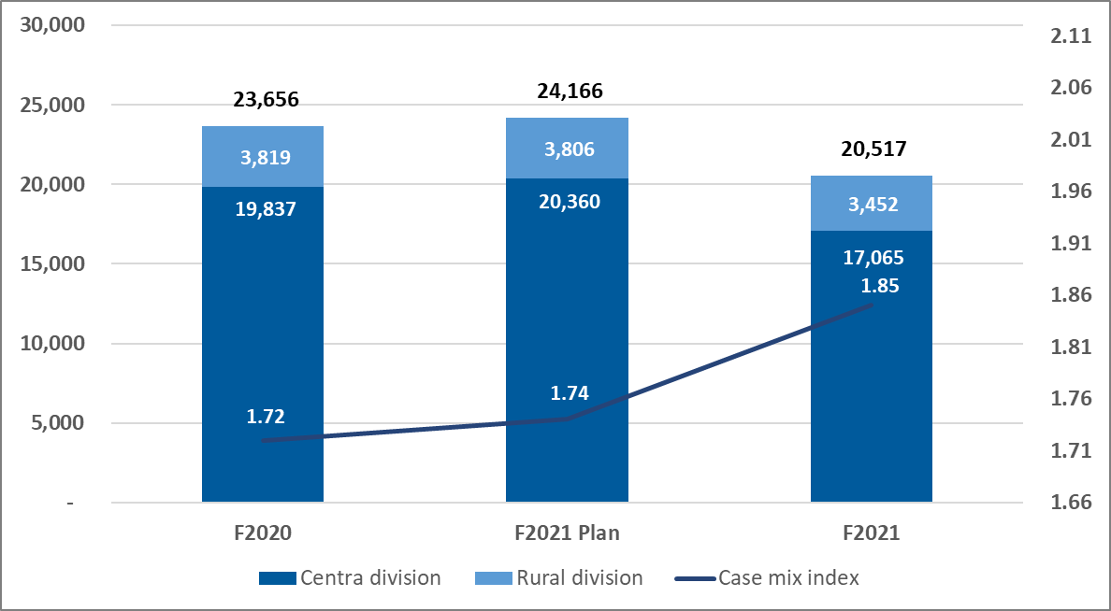
Patient utilization – admissions
Admissions were (15.1%) below plan and (13.3%) below prior year
Admissions remain depressed with January/February average admissions per day (7.9%) below 1st quarter
Case Mix Index continues to exceed plan and prior year due to a higher mix of complex care, lower acute patients delaying care, and the clinical documentation initiative

Slide 7
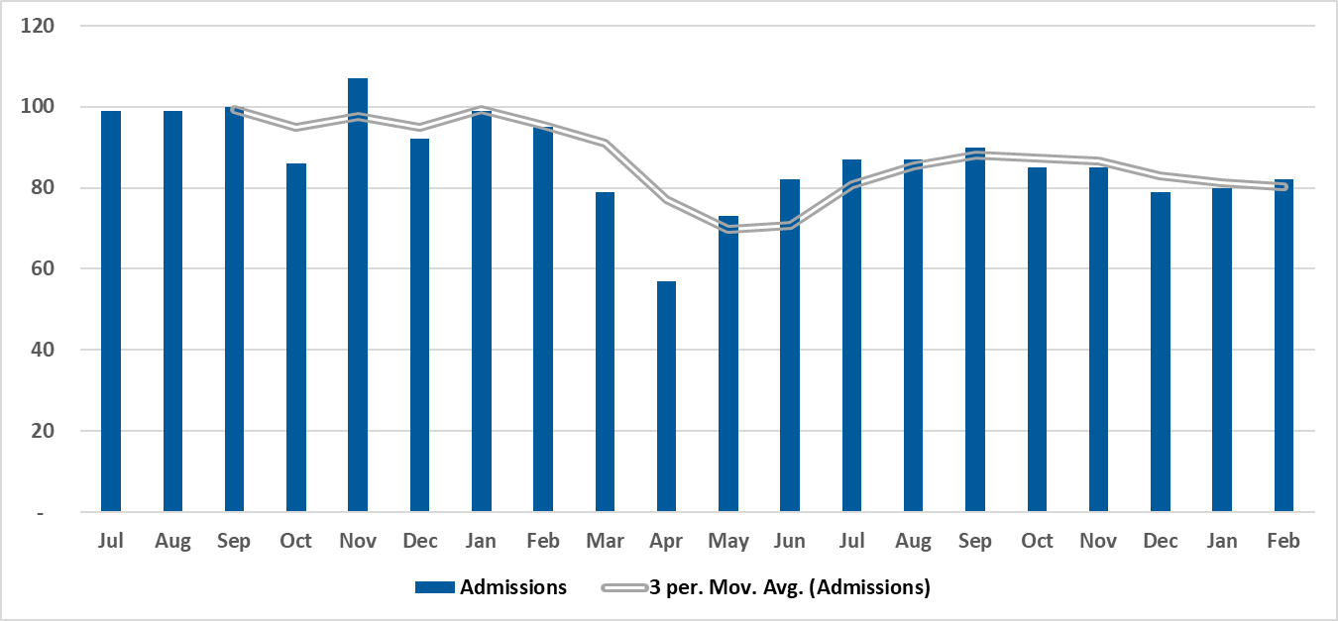
Patient utilization – admissions (per calendar day)
Admissions began to increase following the 1st Covid surge and the initiation of the Road-to-Recovery
Admissions declined during the 2nd Covid surge due in part to managing the surgery schedule to ensure the availability of intensive care unit beds
We have not experienced a significant increase in admissions following the 2nd Covid surge

Slide 8
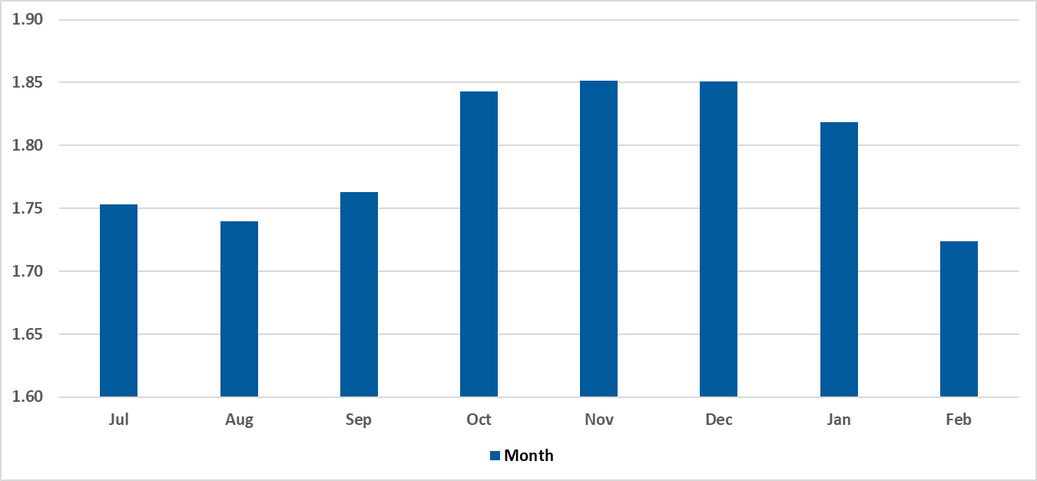
Patient acuity
Patient acuity increased significantly following the 1st Covid surge reflecting patients who avoided care and were admitted in a more acute state, lower acute patients who continue to delay care, and more acute Covid patients
Following the 2nd Covid surge, patient acuity has decreased significantly and is more in-line with historical levels
A continued decrease in patient acuity will have a significantly negative impact on revenues

Slide 9
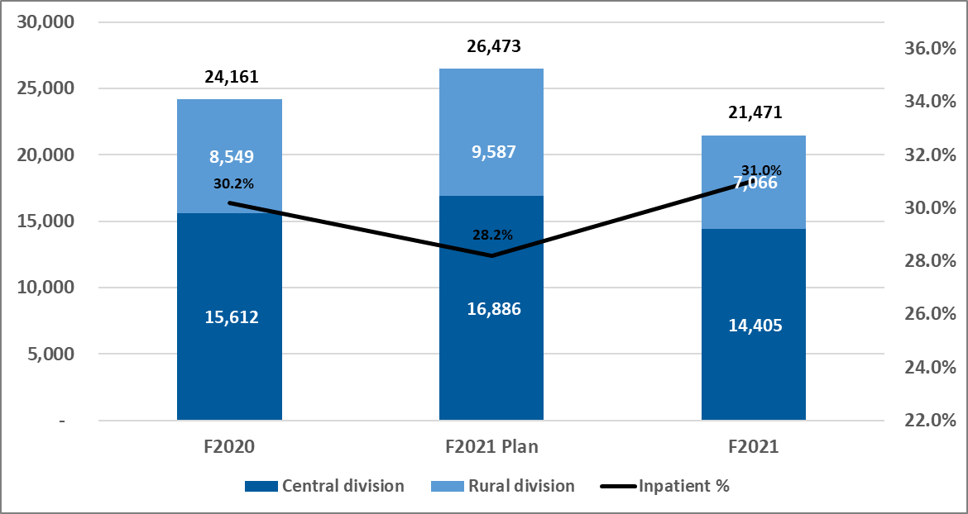
Patient utilization - surgeries
Total surgeries were (18.9%) below plan and (11.1%) below prior year
Surgery volume has slowly increased with average surgeries per day in January/February +1.4% to 2nd Quarter and +3.3% to 1st Quarter, but remains well below planned levels
Inpatient surgeries were (10.8%) below plan and outpatient (22.1%) below plan, resulting in a higher mix of inpatient surgeries
Note: The Monticello Surgery Center was fully integrated into the Central division in December of F2020

Slide 10
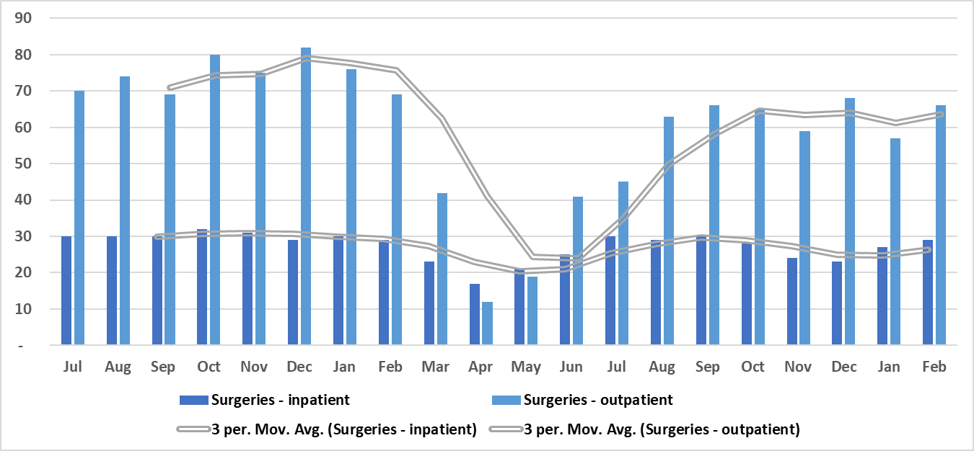
Patient utilization – surgeries (per calendar day)
Inpatient surgeries were approaching historical levels prior to the 2nd Covid surge, declined during the 2nd surge as we managed bed capacity, and, although increasing post 2nd Covid surge, remain below historical levels
Outpatient surgeries initially increased significantly following the 1st Covid surge, due to the Road-to-Recovery, but have remained significantly below historical levels
Note: The Monticello Surgery Center was fully integrated into the Central division in December of F2020

Slide 11
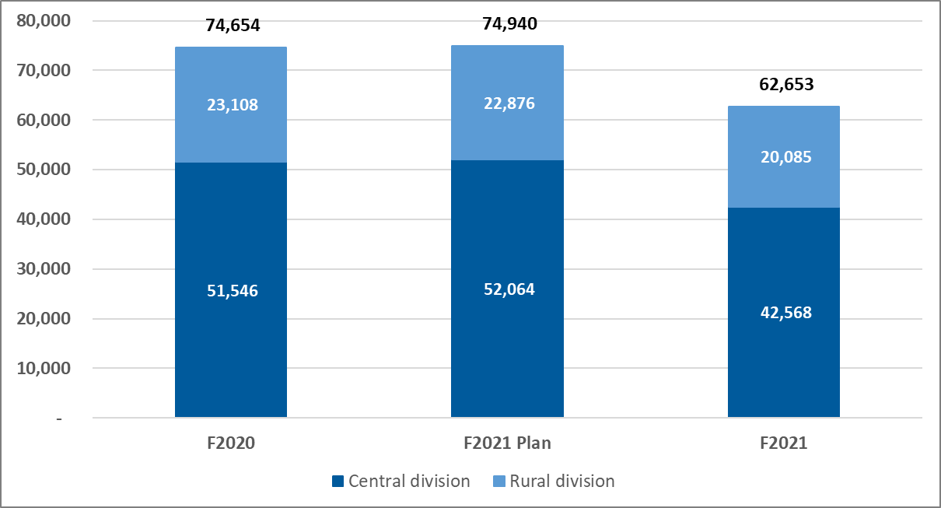
Patient utilization – ER visits
Emergency Room visits were (16.4%) below plan and (16.1%) below prior year
We continue to experience a decrease in lower acute patients that likely reflects lower levels of non-Covid infectious diseases and patients who remain hesitant to seek care
National trends indicate emergency room visits are down (25%) as compared to pre-Covid levels

Slide 12
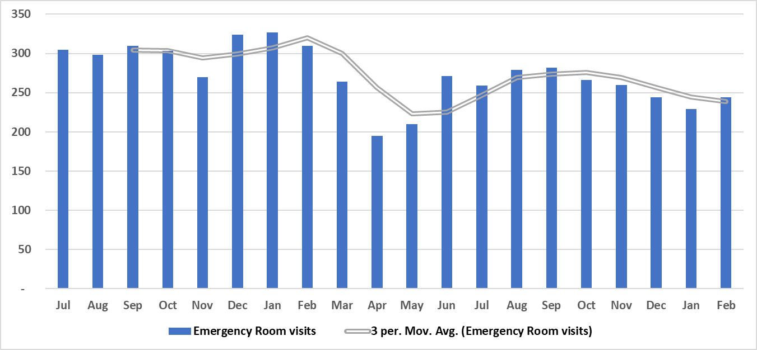
Patient utilization – ER visits (per calendar day)
Emergency Room visits remain significantly below historical levels
Visits are trending downward which likely reflects a milder infectious disease season and continued reluctance to seek care
Although it would be a positive trend if patients were shifting to primary care or urgent care versus the emergency room, we haven’t seen significant increases in visits to those clinics

Slide 13
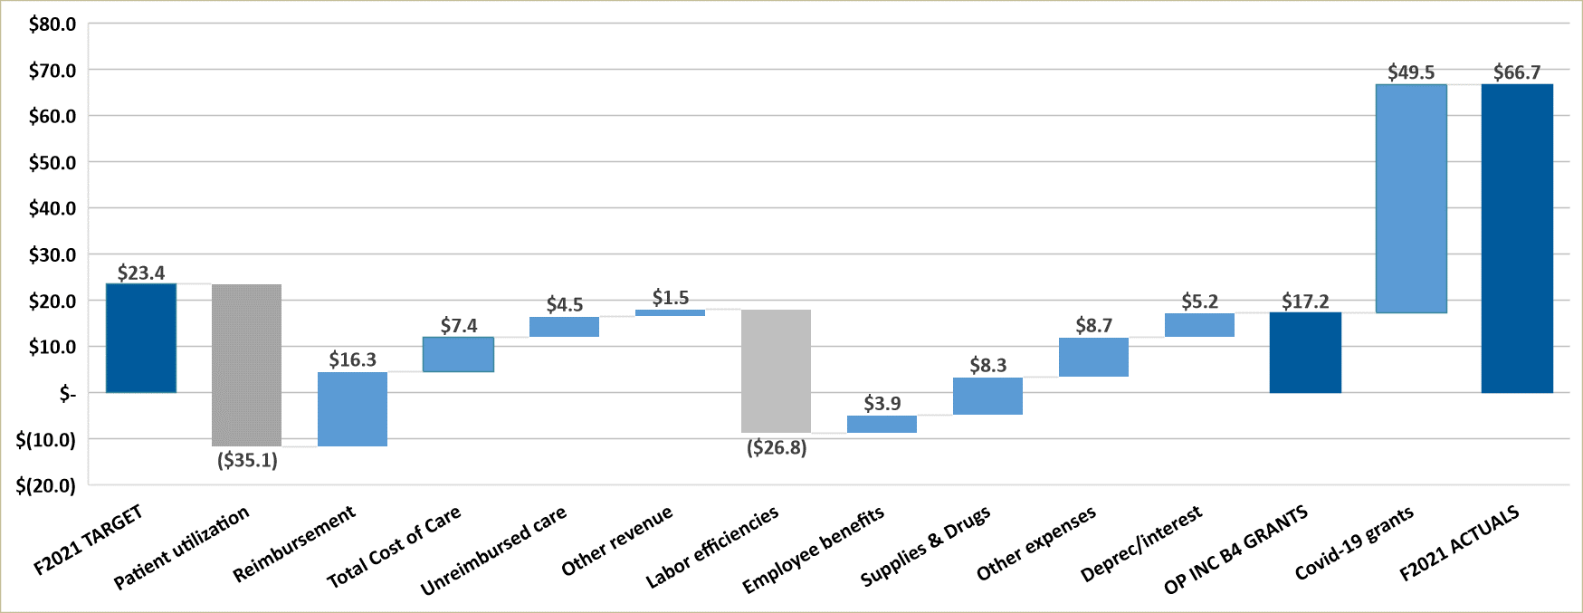
Financial results – variance to plan
Operating income of $66.7M was $43.3M higher than plan due to $49.5M of Covid grants recognized and earlier TCOC revenues
  Excluding Covid grants & earlier recognition of TCOC, operating income would have been $9.8M, ($13.6M) below plan
The negative impact of the lower patient utilization now significantly exceeds, ($18.8M), the positive impact of higher patient acuity
Labor inefficiencies reflected the early unwinding of the Covid cost reduction strategies and higher labor costs following the 2nd Covid surge
Notes:
Mike

Slide 14
Financial summary
Operating income of $66.7M was $43.3M favorable to plan
Covid-19 related grants of $49.5M were recognized
Total Cost of Care (TCOC) revenues were recorded earlier than in past years, resulting in a $7.4M favorable timing variance
Excluding the Covid-19 grants and the earlier recognition of TCOC revenue, operating income would have been $9.8M, ($13.6M) below target
The negative impact of lower patient utilization now significantly exceeds, ($18.8M), the positive impact of higher patient acuity
Labor costs are ($26.8M) unfavorable due to the early unwinding of the Covid related workforce strategies and higher labor costs following the 2nd Covid surge
Non-labor related costs were favorable due mostly to delayed spending and lower costs of personal protective equipment

Slide 16
2021 CMS wRVU
Provider Fee Schedule Change
Physician & APP Leader Meeting
April 6, 2021

Slide 17
Agenda Topics
CMS Change
PCAC Review & Recommendation
Communication

Slide 18
CMS Change
Greg von Elbe

Slide 19
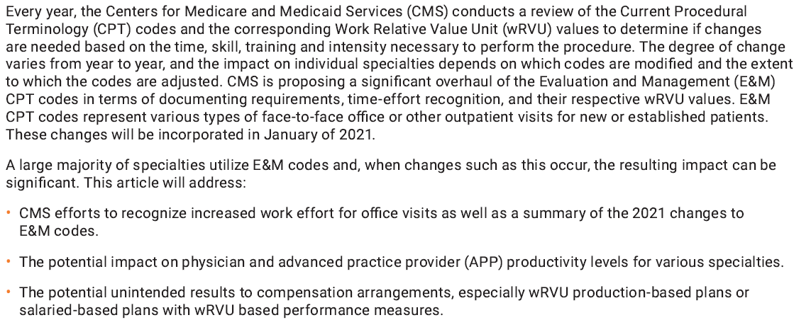
2021 Evaluation and Management CPT Codes:
Understanding the impact on Provider Compensation

Slide 20
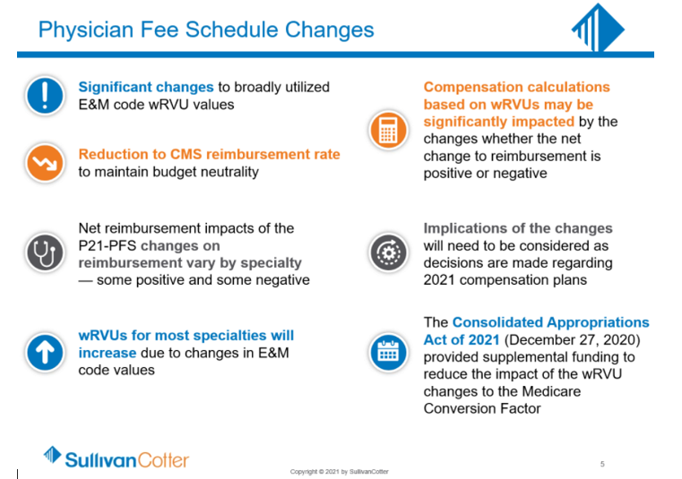

Slide 21
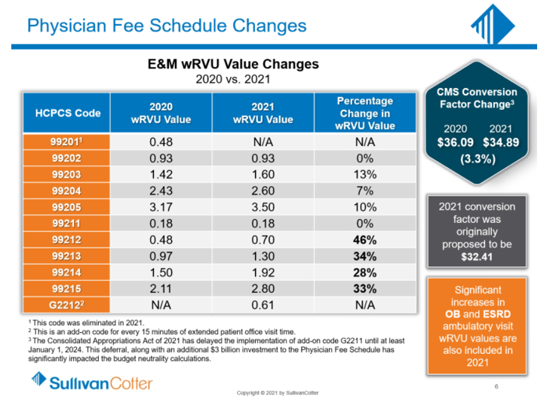

Slide 22
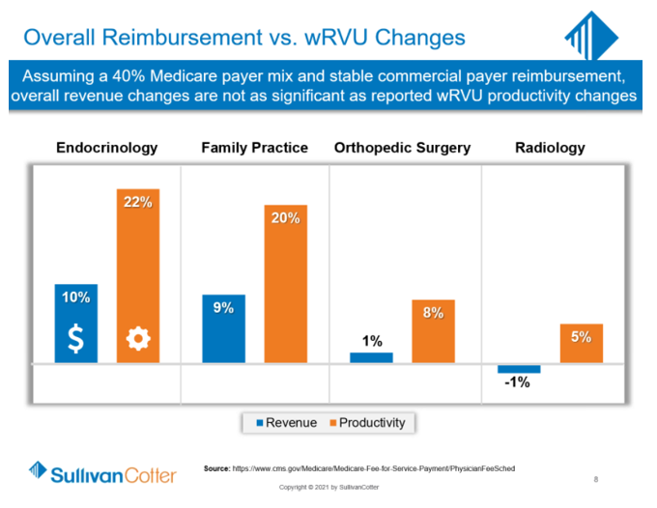

Slide 23
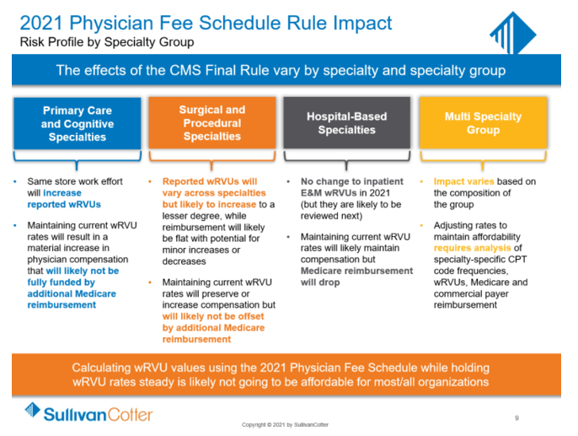

Slide 24
PCAC Review & Recommendation
Tom Schrup, MD, Tom Feldhege & Greg von Elbe

Slide 25
Merits of RVU scale year 2020 vs. 2021
2020 wRVU
Pro
Consistent metric, familiar
Con
Does not recognize increased EM values
Communications
2021 wRVU
Pro
Neutral Financial Impact to Org
Recognizes EM work effort
Benchmarking data disrupted
Tiered comp model ops
Financial Impact to Org
Communications
Con
Tremendously Complex
Tiered comp model thresholds will need to be addressed
Non-Medicare payer impacts unknown
Benchmarkable to prior and market
Comp CF updates as in the past

Slide 26
Unmitigated Impacts of 2021 Scale Year wRVU Changes Applied to “Same Store” Volumes in Production Based Comp Models
Overall wRVU increase 8.1%. Range of 0% to 28% by specialty.
  Primary Care and Ambulatory Based ~6-28%
  Surgical and Procedural ~1-12%
  Hospital Based ~0-5%
New Compensation Expense of $11.0 Million

Slide 27
FY22 “Normal” Compensation Program Update
Aggregate FY22 “Normal” Compensation Rate Change 2.0% (FY21 2.2%)
Professional Net Revenue Change ~2.3% (Last year ~0.6%)

Slide 28
Developed Objectives for FY22
Which model best achieves:
  Recognizes CMS intent of increased EM work
  Financially feasible
  Cognizant of national and regional market approaches
  Acceptable pace of change
    Guardrail parameters

Slide 29
Options Considered for Implementation of 2021 Scale Year in Physician wRVU Compensation Models
Model A
Does not Redistribute Compensation
Adjusts CF rates for use with 2021 scale year and “Typical” annual FY22 comp rate change
Model B
Recognizes CMS Change
Applies global “Adjustment” Factor and restates CF rates for use with 2021 wRVU
Wide Range of Impact (+25% / -8%)
Model C
Recognizes CMS Change
Applies Standard Internal Guardrails (+10% / -2.5%)
Adjustment to CF Factor to ease in changes
Compromise
Model D
Recognizes CMS Change
Modifies Lower Guardrail (+10% / -0%)
Larger Adjustment to CF Factor to ease in changes
Compromise

Slide 30
CentraCare Analysis – Select Specialties

Slide 31
CentraCare Analysis – Select Specialties cont.

Slide 32
CentraCare Analysis – Detail

Slide 33
CentraCare Analysis – Detail cont.

Slide 34
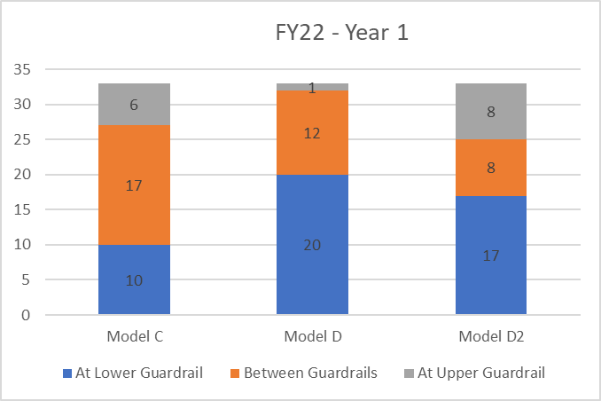
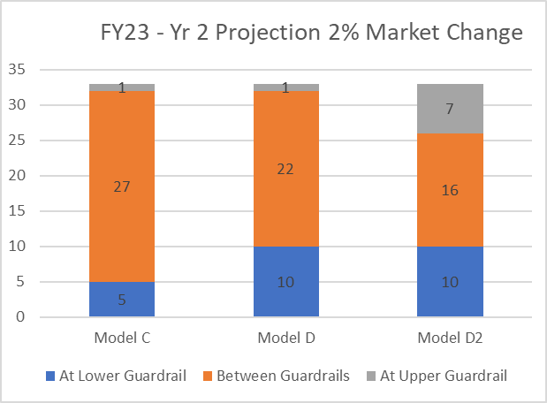
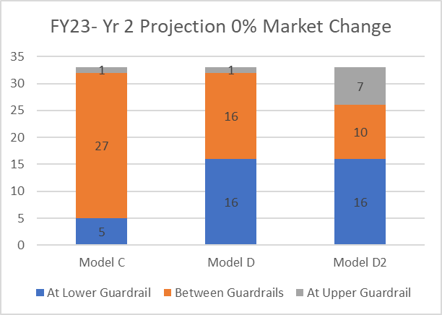
Analysis of Count of Specialties Impacted by Guardrails:
Model C +10% / -2.5% Model D +10% / -0% Model D2 +5% / -0%

Slide 35
Recommendation for FY22:
Which model best achieves:
  Recognizes CMS intent of increased EM work
  Financially feasible
  Cognizant of national and regional market approaches
  Acceptable pace of change
    Guardrail parameters
PCAC Recommendation of 3.5.2021:
    Guardrails of +10% / -0% (a.k.a. “Model D”)
    Reassess in 1 year for FY23

Slide 36
Implementation into FY22 Physician Compensation Models
Utilize CMS 2021 wRVU Schedule
Restate wRVU thresholds for 2021 wRVU Schedule
Restate conversion factors for implementation factor and guardrail application.
  Financial feasibility
  Acceptable pace of change
Apply recommendation into 10+ Compensation Models

Slide 37
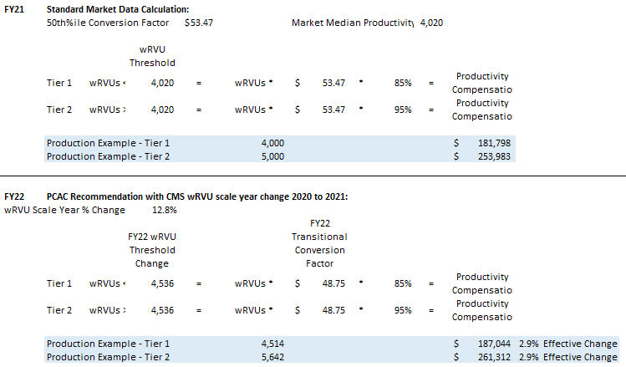
FY22 Physician Compensation Model Update – Production Model

Slide 38
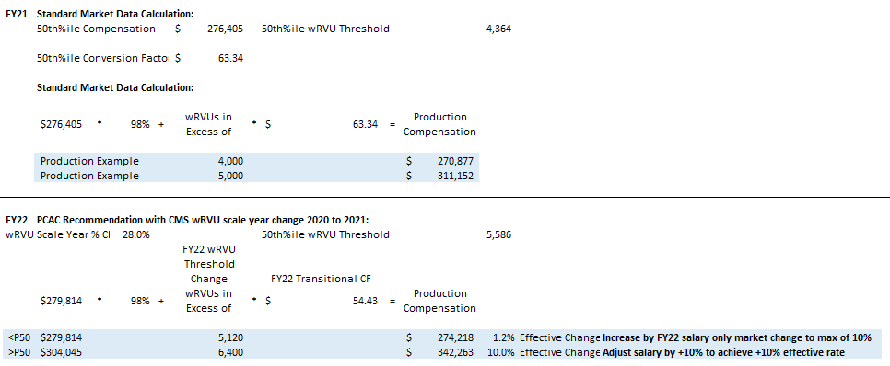
FY22 Physician Compensation Model Update – Salary + Production Model

Slide 40
Communication
Tom Schrup, MD

Slide 41
Timeline
CPRO: Need to Know Oct 2
CMS Final Rule Dec 2, CAA Dec 27
Provider Leadership, CPRO site

Slide 42
Communication/Next Steps
Primary communication will be through the dyad structure
  This meeting and follow up conversations
  Slide deck from this meeting
Supplementary communications through Clinical Partner Website
FY22 Physician Conversion Factor/Salary Updates to Specialties
  PowerPoint updating conversion factor or salary change from FY21 to FY22 based on PCAC recommendation will be sent to Section Dyad Partners the week of April 12, 2021 to communicate information to physicians by June 1, 2021.

Slide 44

Opportunities in standard documentation and E&M: CDI, CODING and compliance intersection
Physician and APP leadership meeting
April 6, 2021
​
Jessie Roske, MD (IM hospitalist SCH)​
Medical Director for Clinical Documentation Integrity​
Ann Zierden, BSN, RN, CCDS CDI Manager
Sue Stein, CPC Compliance Manager
Penni Drews, Coding Manager
​
​

Slide 45
Vision of the program
Clinical Documentation Integrity: Inpatient and Outpatient working jointly
Reimbursement/ LOS: Acute care DRG
Evaluation & Management/ Professional fees
Denials management:
Inpatient Care/Medical Necessity
Clinical Validation
Quality metrics
Accurate healthcare profile
CDI is a system level priority that aligns acute care needs with population health and provider engagement, meeting the needs of providers for all aspects of documentation, providing the tools and education to ease the burden of the work as much as possible.
Backbone of CDI: Provider education with CDRN, coding and compliance support

Slide 46
Organizational citizenship
Administration Responsibilities
Offer the necessary knowledge available to do the task
Provide the tools to do the work
Provider Responsibilities
Complete the task with timely and quality outcome
Use the tools
Treat staff with respect
Employ adequate support staff to do the work efficiently and correctly
Compliance analysts and coding staff
Notes
Education including individualized information
Organization Compact

Slide 47
prepare for New E&M Regulation for all ambulatory providers
Development of intensive 2-hour workshop
Extensive communication plan and logistical endeavor
  670 providers, scribes, and coders attended
  Share data
  Ongoing education based on findings after go-live

Slide 48
Process measure: feedback from providers
*from cme surveys and unsolicited email feedback
98.8% felt that they understood the 2021 E&M changes and how to use the Epic support tools
"Thank you! It was a great info session. I feel more confident, but need to practice!"
"Well delivered conference."
"It was very clear that you were trying to make this as easy and productive for providers as possible."
"This was a tremendous presentation. So well done by both physicians!"
"Very informative. Thank you for taking the time to do this."
"A whole new world!!! Great job!"
"May changes – great presentation."
"I will try standardized notes again."
"Learned tons! It was fantastic."
"Standard note. I like it!"
"Learned how to get credit for my work! Appreciate all the support for this difficult change."
"Very well done."
"Well organized."
"Great info!"
"Well presented"

Slide 49
Outcome measure: initial indicators jan 2021
395 providers with ≥25 established care visits
  268 at goal* (67.8%)
127 providers with opportunity
  44 improved from their 2020 baseline (11.1%)
  28 unchanged from their 2020 baseline (7.1%)
  55 worsened from their 2020 baseline (13.9%)
Initial data shared via emails to individuals with opportunity and to dyad leadership 2/28-3/8/2021
*Defined as within 10% of peer group; a few identified as not at goal with clinic generally demonstrating opportunity

Slide 50
Outcome measure: initial indicators jan 2021
 | Attended | Didn't attend
Among those at goal versus peers: 268 | 172 (64.5%) | 96 (35.8%)
Among those with opportunity versus peers: 127 | 70 (55.0%) | 57 (45.0%)

Slide 51

Next steps
Individual audits going to clinic providers with opportunity and dyad leaders beginning 3/10/21
Will have clinic E&M data for all April/May 2021
Biannual INPATIENT CDI course coming up!
  Introduction to CDI
  Acute care diagnosis capture
  E&M for the acute care environment
  3 hours CME and MOC credit
  April 7 and April 14, both from 7:30-11:00 AM by webex
Expanding to AMBULATORY AND INPATIENT courses this fall

Slide 53
Discussion/Questions

Slide 54
Summary &
Requested Actions
Financials from February were poor due to ongoing low patient utilization and unfavorable labor costs. Improvement plans are under development.
The significant CMS E&M changes for 2021 were reviewed. Our response to the changes including philosophy, modeling, and decisions were presented.
An initial approach to communication of this information to frontline staff was discussed. We will alter this based on your feedback. Please provide it. We understand that this will be a process
Dr. Jessie Roske provided a CDI update with a focus on recent ambulatory E&M training and results. Please encourage ongoing participation in improvement and educational efforts.

